Slide 2
Living the Life
Vs. 4:2-6

Slide 3
Prayer
Vs. 2-4

Slide 4
We don’t give up on prayer because we don’t give up on Jesus.
Prayer considers my need His problem.

Slide 5
"Never undertake more than you can cover beforehand in believing prayer.“
Alan Redpath

Slide 6
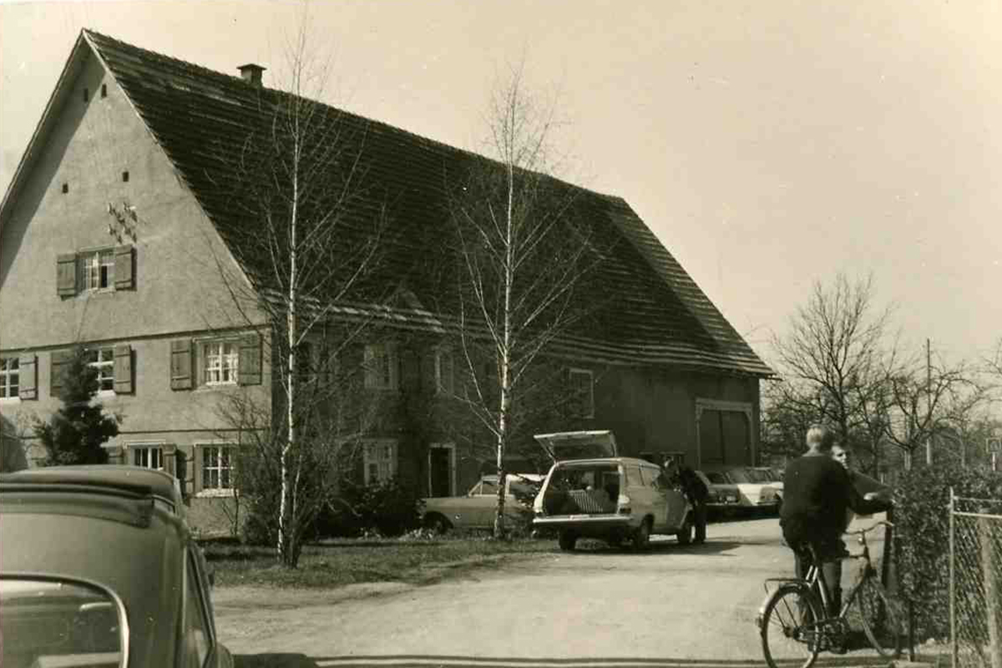

Slide 7
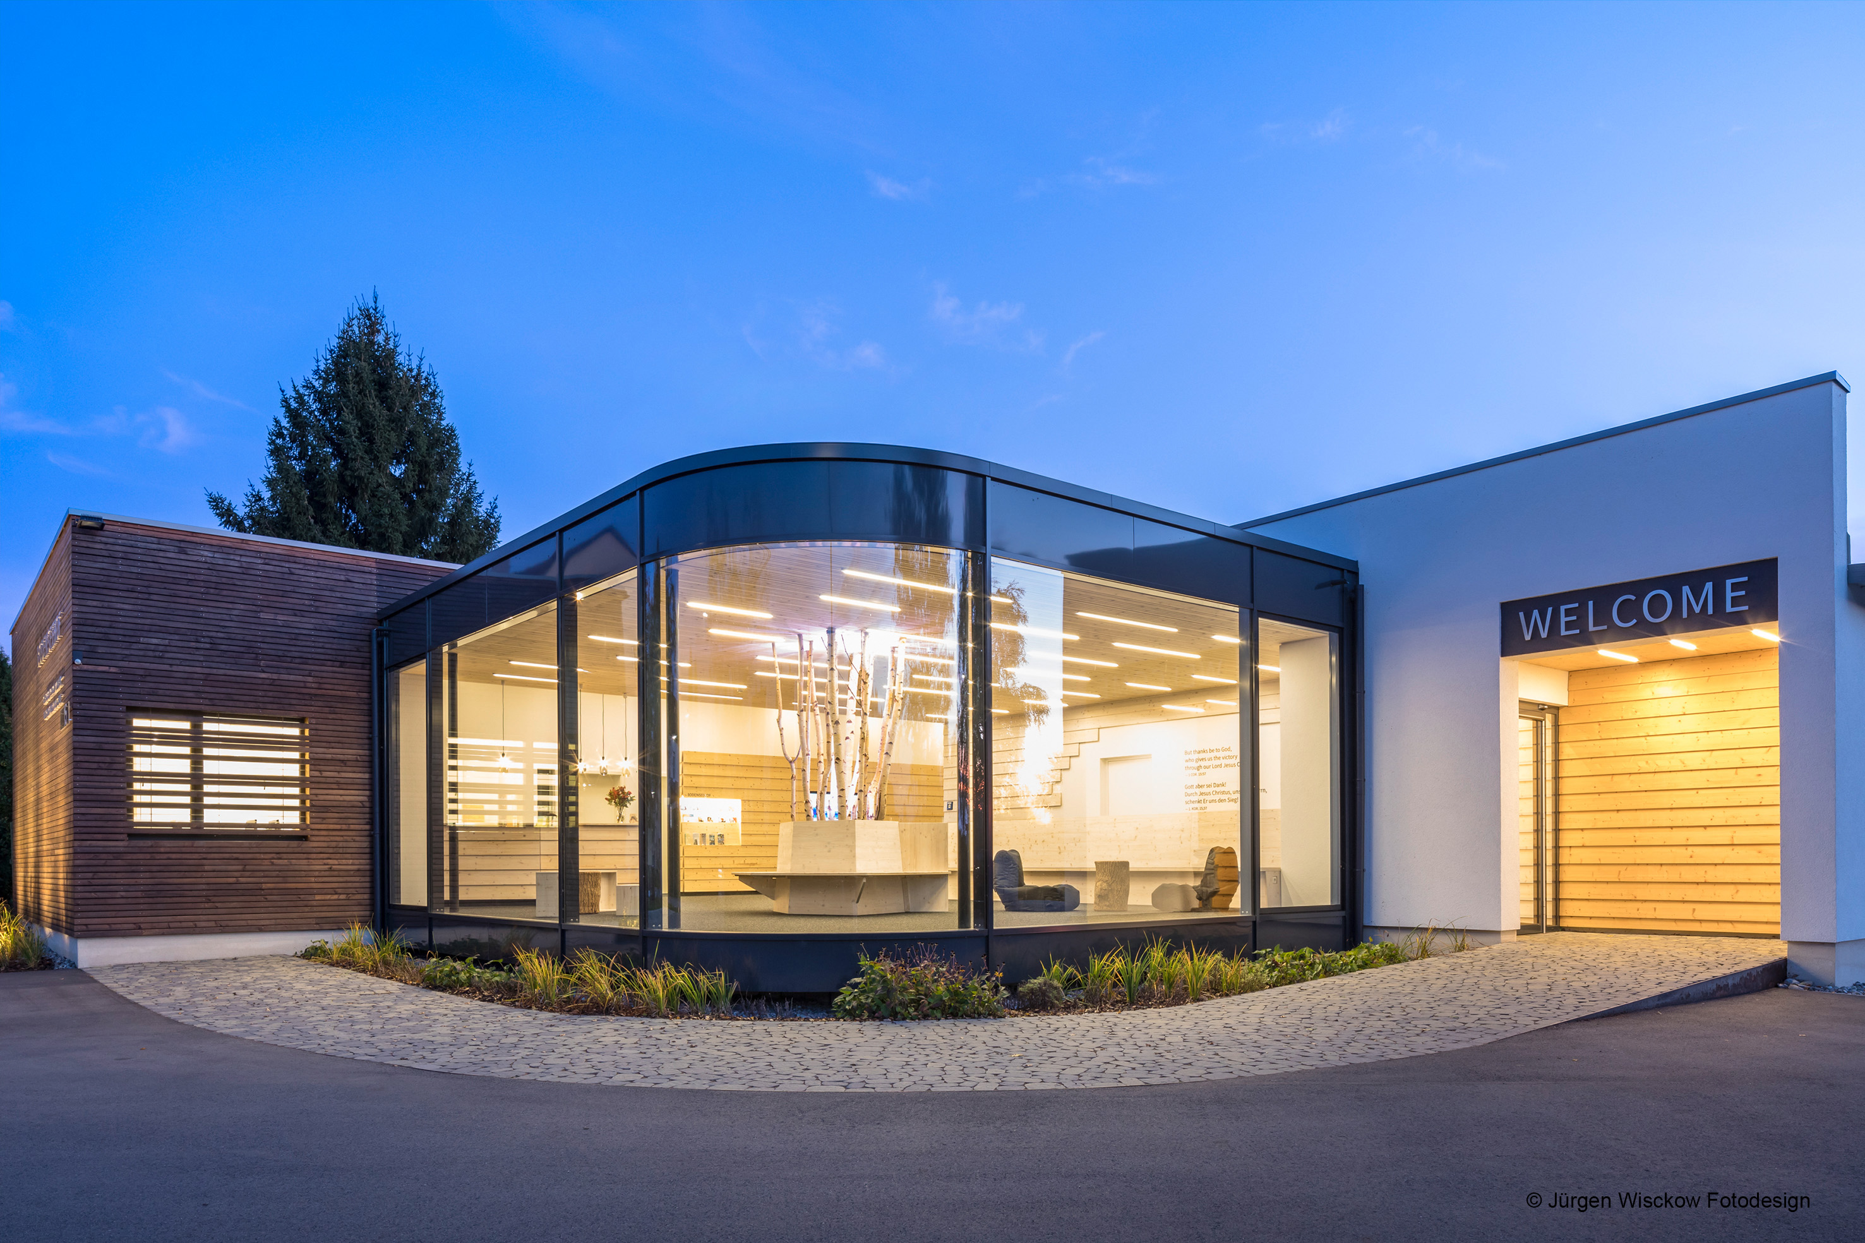

Slide 8
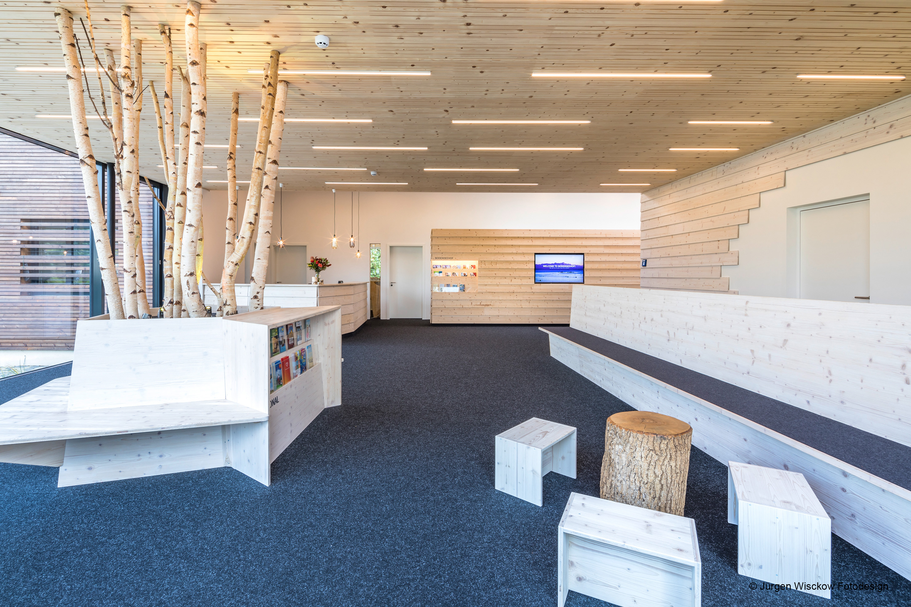

Slide 9


Slide 10
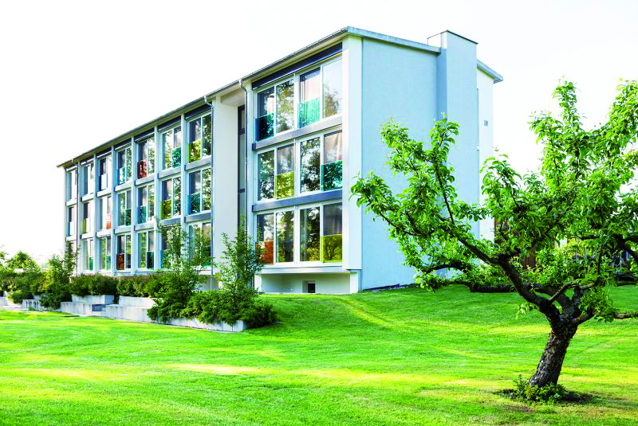

Slide 11
The chief end of prayer is not to get answers but to get to know God!

Slide 12
Carry on an unheard conversation with God!
Eph. 6:8; 1Thess. 5:17; 1Pet. 4:7; Neh. 2:1-7

Slide 13
Public
Vs. 5
Eph. 5: 15-17; 2Sam. 11:1

Slide 14
If it reaches you, it first went by Him.
Ps. 118:24

Slide 15
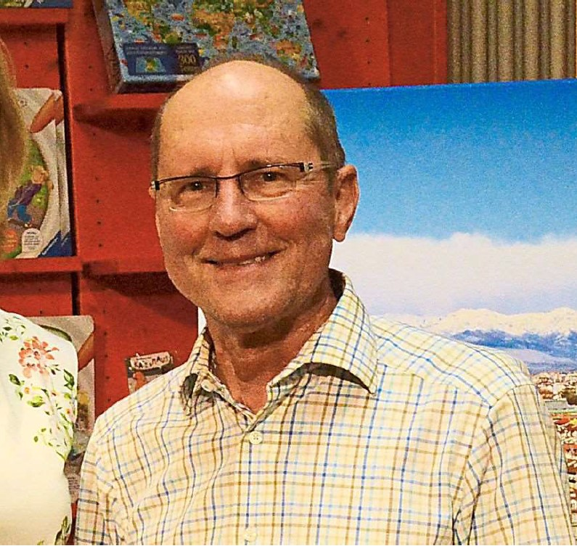

Slide 16
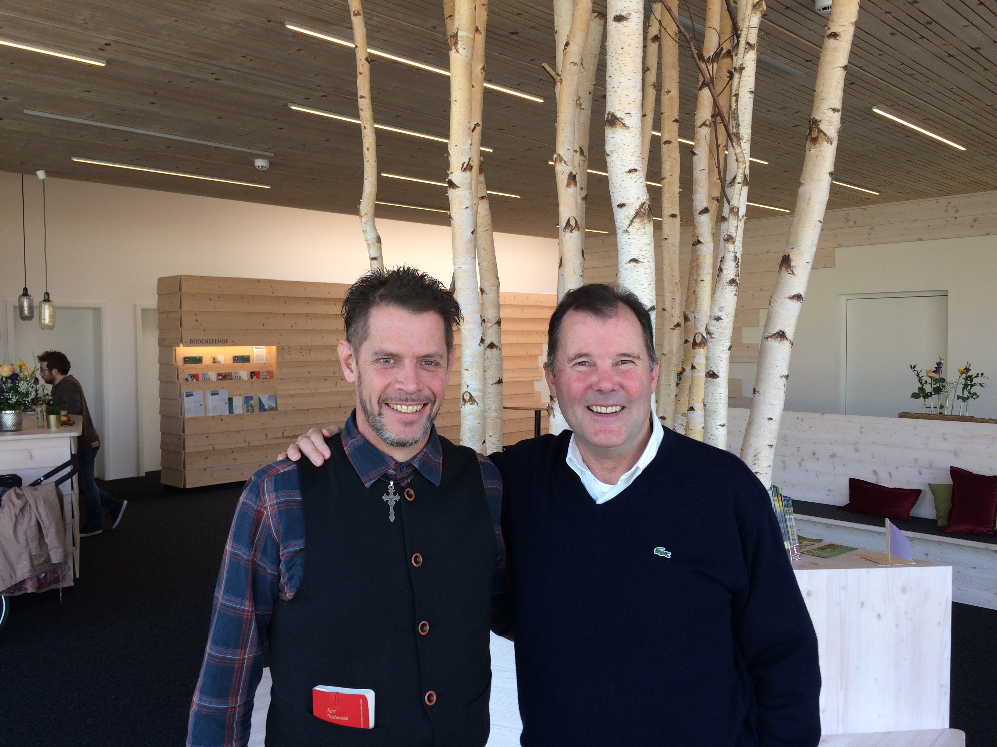
Public
Vs. 5

Slide 17


