Slide 2
Harvest
Col. 1:3-8

Slide 3
Grace and Truth
The grace of God meets the need which the truth of God exposes.
Jn. 1:14,17; Rom. 5:20; Rom. 6:1; Rom. 10:10
Acts 19:19-20

Slide 4
The law of the harvest:
The harvest is greater than that which is sown.

Slide 5
…for you have been born again not of seed which is perishable but imperishable, that is, through the living and enduring word of God. For “ALL FLESH IS LIKE GRASS, AND ALL ITS GLORY LIKE THE FLOWER OF GRASS. THE GRASS WITHERS, AND THE FLOWER FALLS OFF, BUT THE WORD OF THE LORD ENDURES FOREVER.” And this is the word which was preached to you.
1Pet. 1:23-25 (Is. 40:6)

Slide 6
“The kingdom of God is like a man who casts seed upon the soil; and he goes to bed at night and gets up by day, and the seed sprouts and grows—how, he himself does not know. The soil produces crops by itself; first the blade, then the head, then the mature grain in the head. But when the crop permits, he immediately puts in the sickle, because the harvest has come.”
Mk. 4:26-29

Slide 7
For this reason, we also constantly thank God that when you received the word of God which you heard from us, you accepted it not as the word of men, but for what it really is, the word of God, which also performs its work in you who believe. 1Thess. 2:13

Slide 8
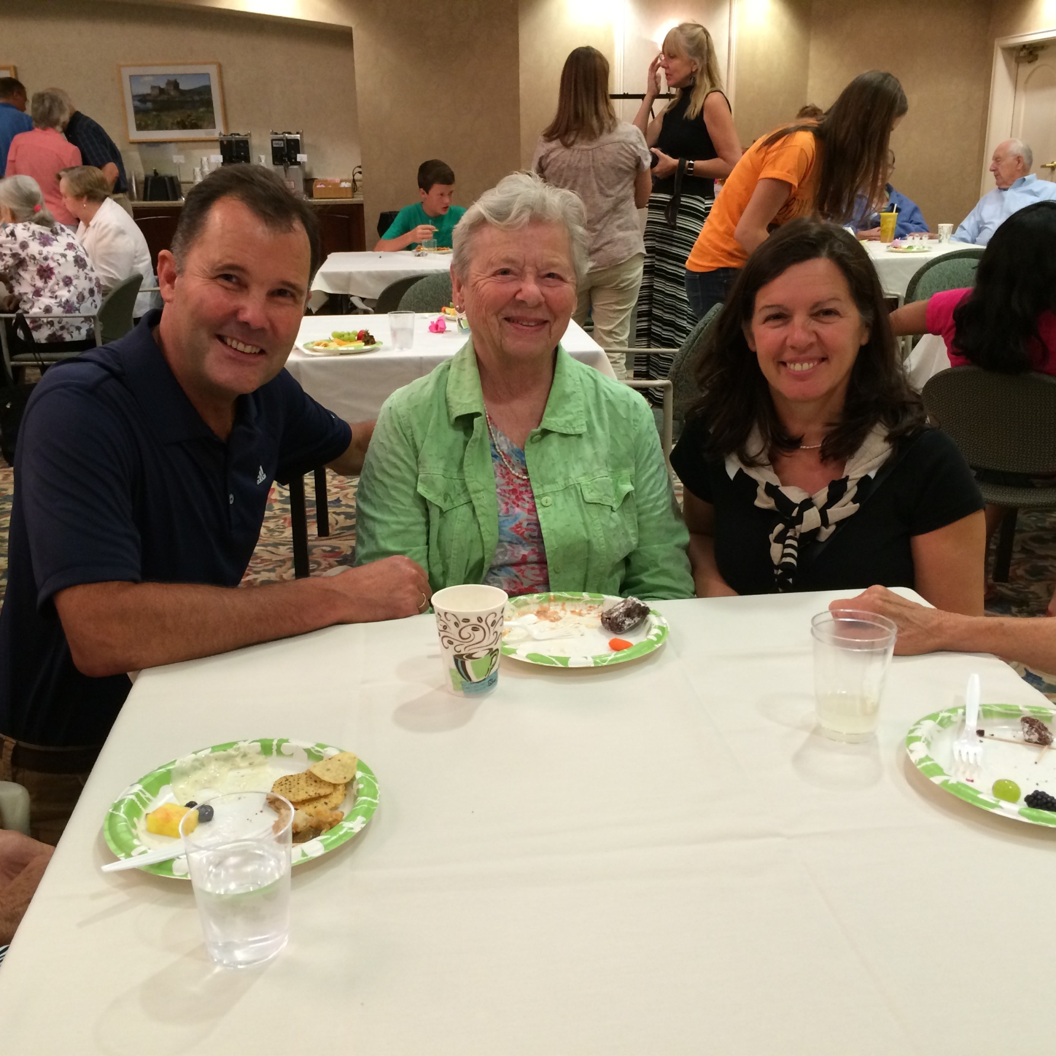

Slide 9
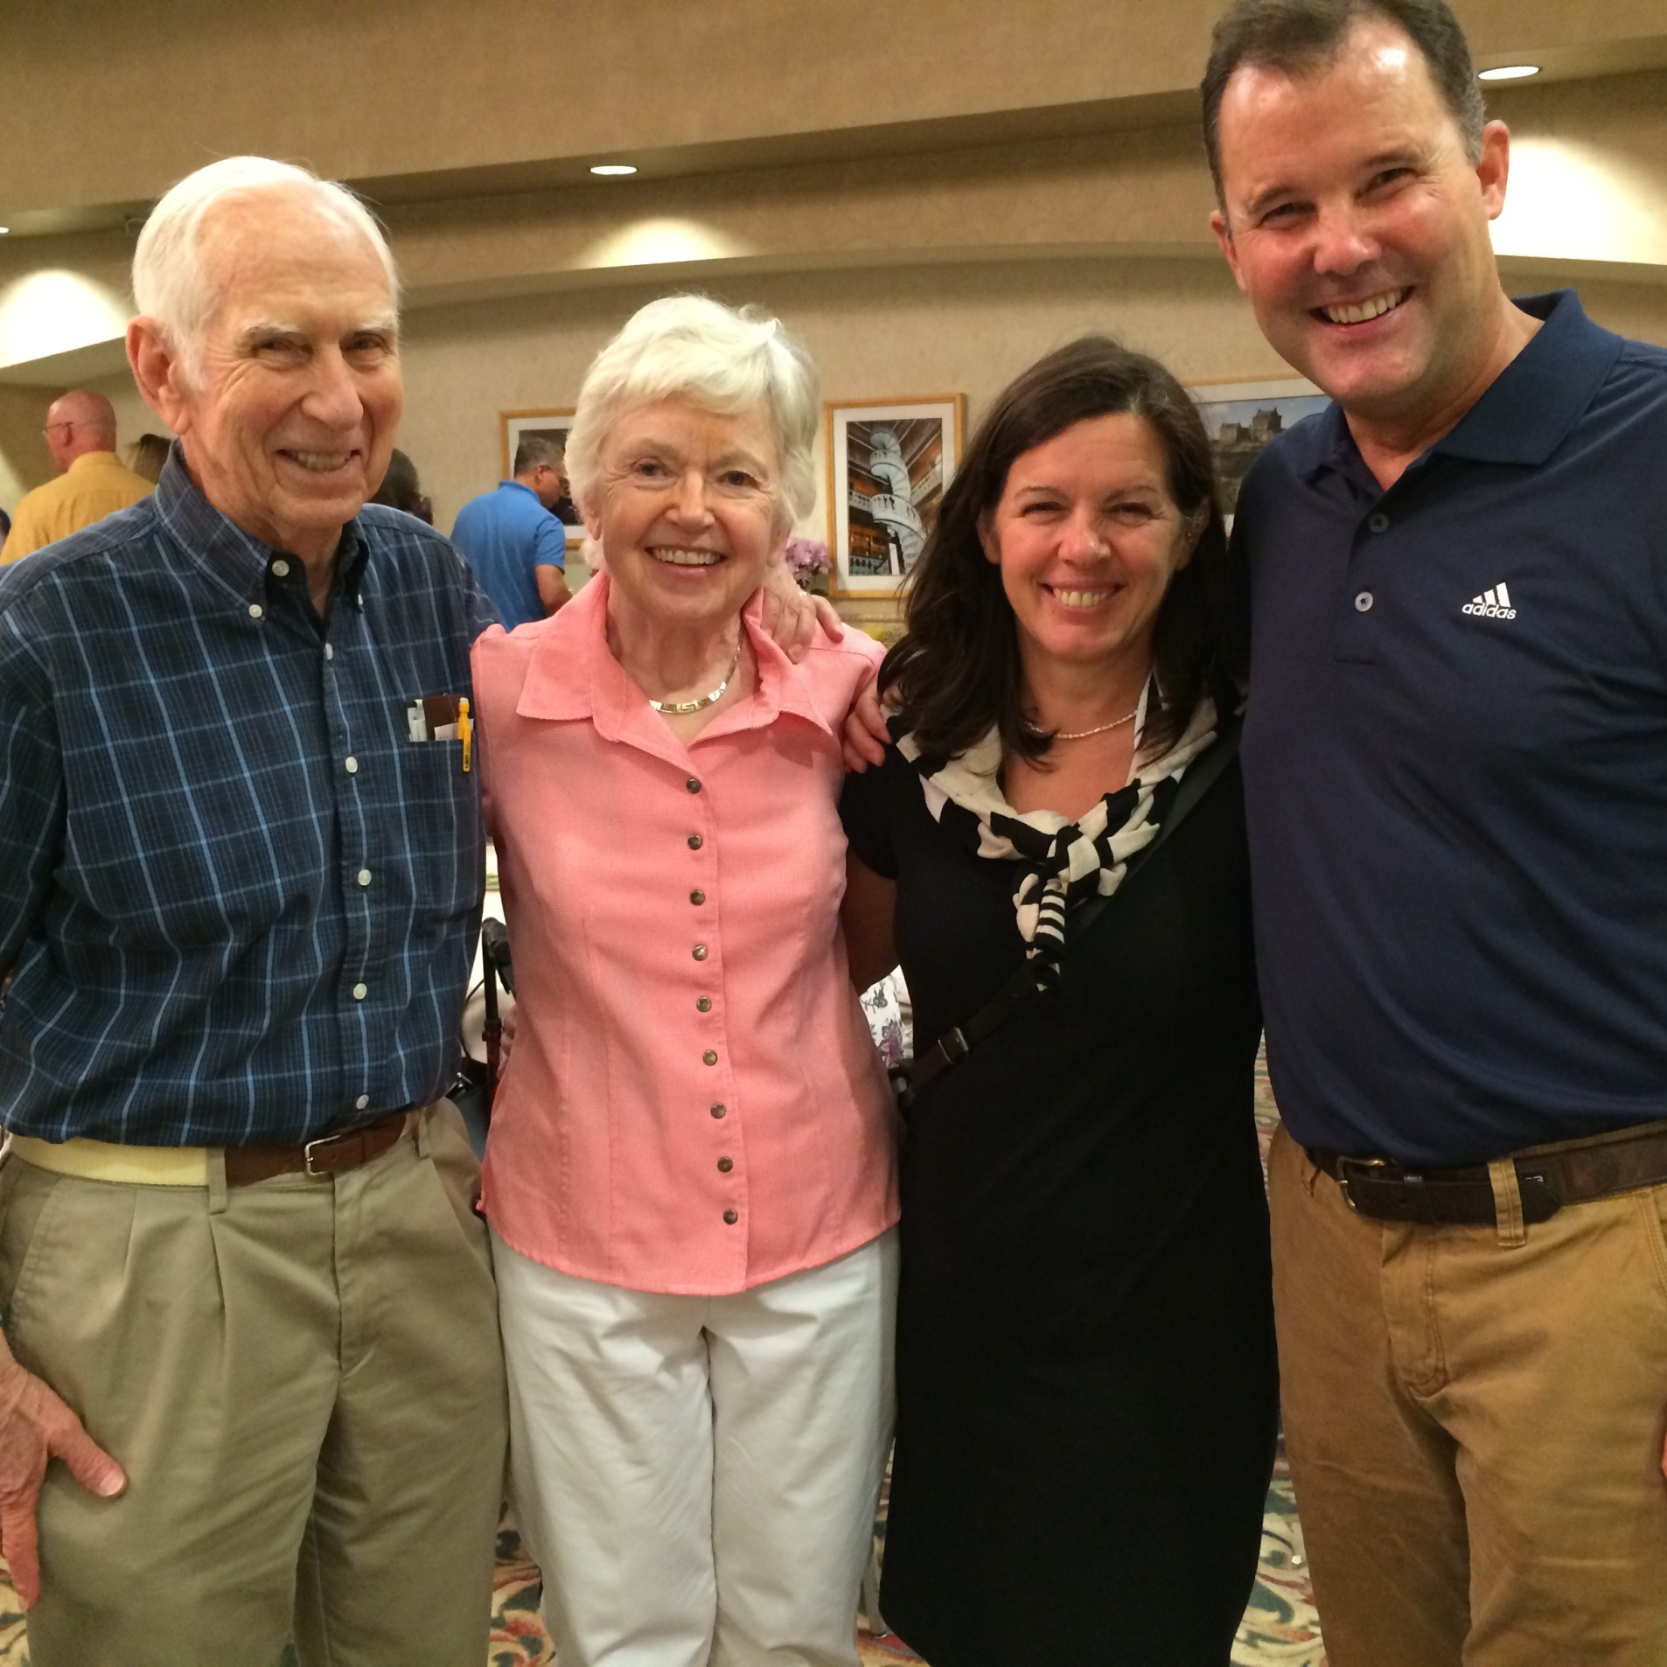

Slide 10
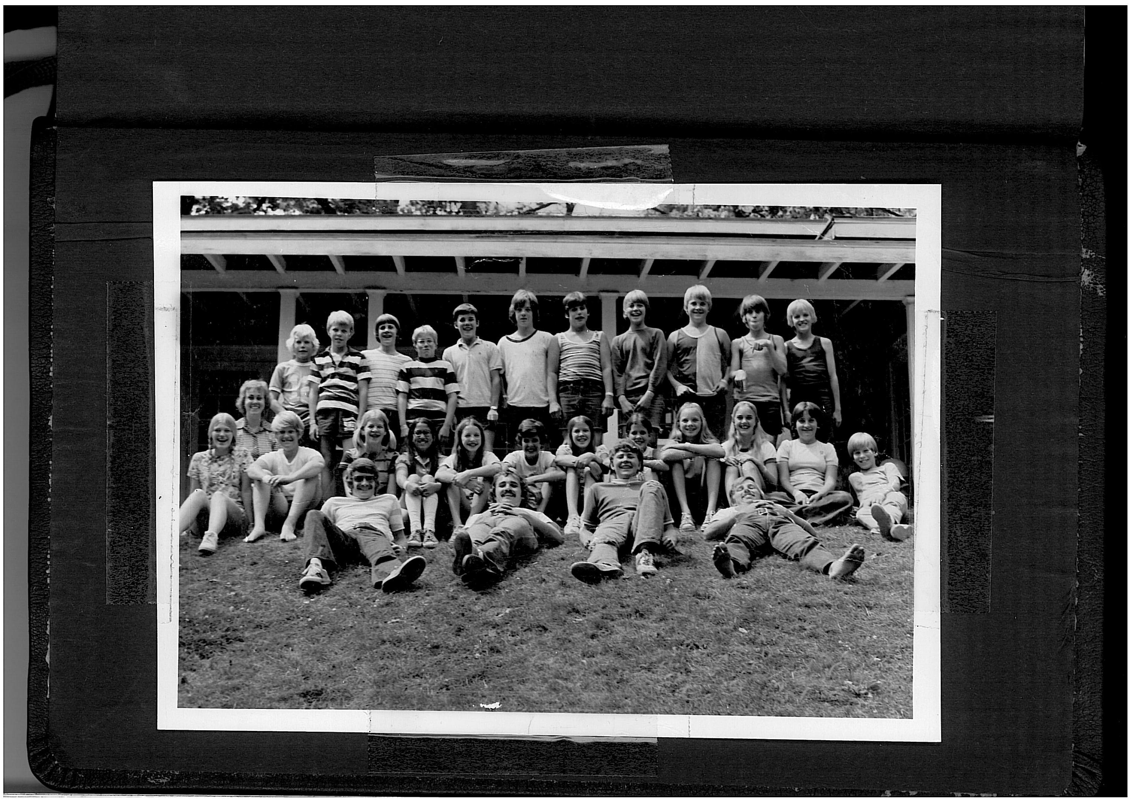

Slide 11
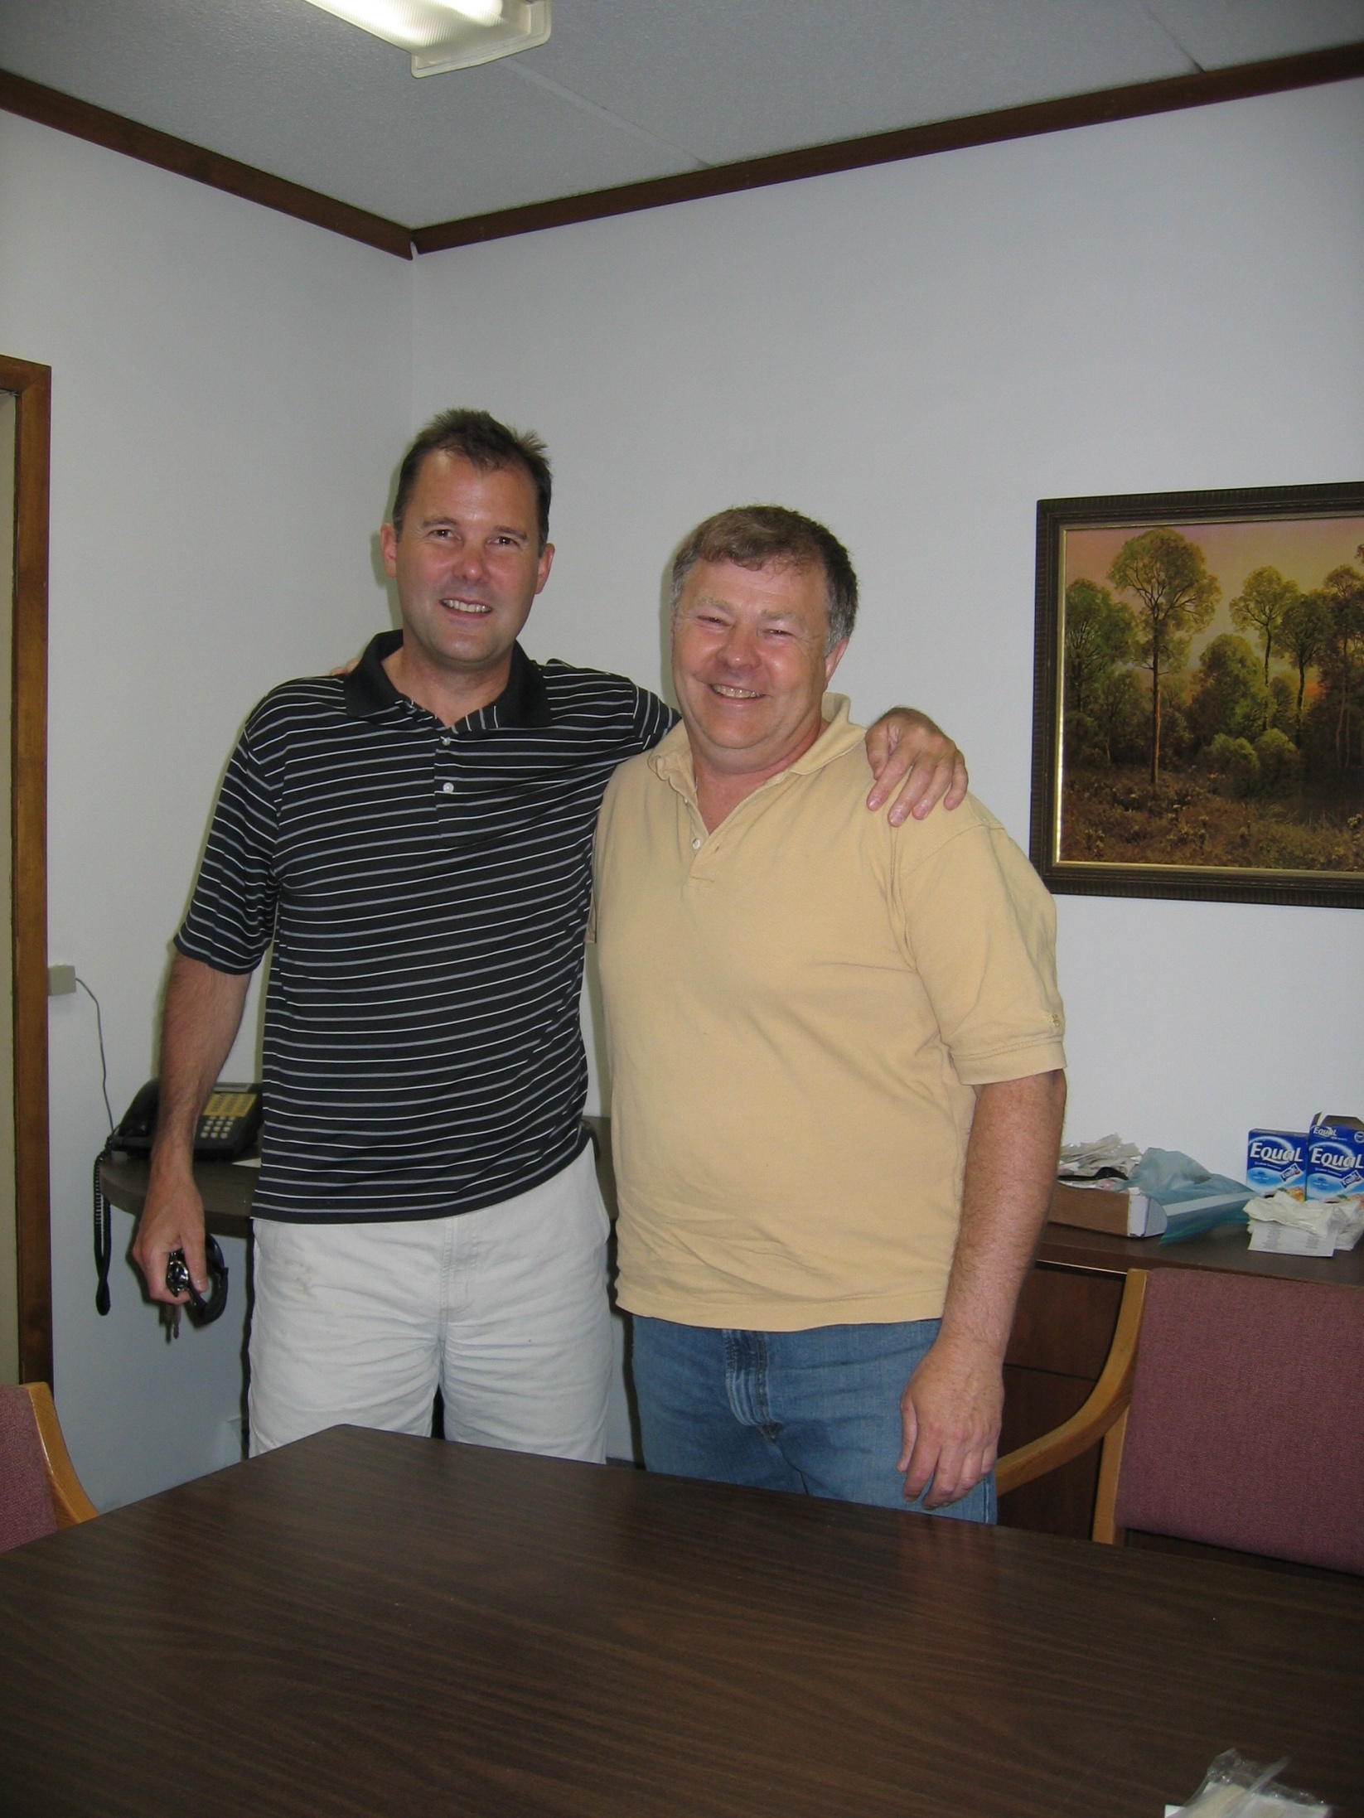

Slide 12
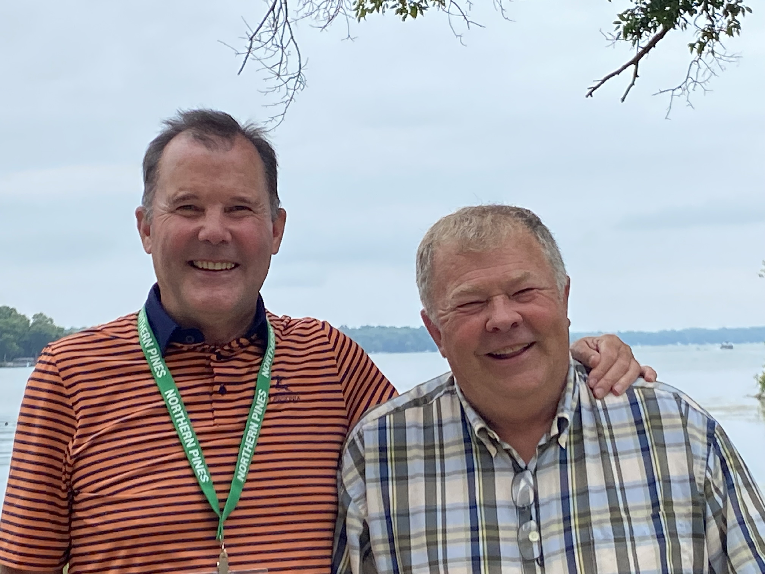

Slide 13
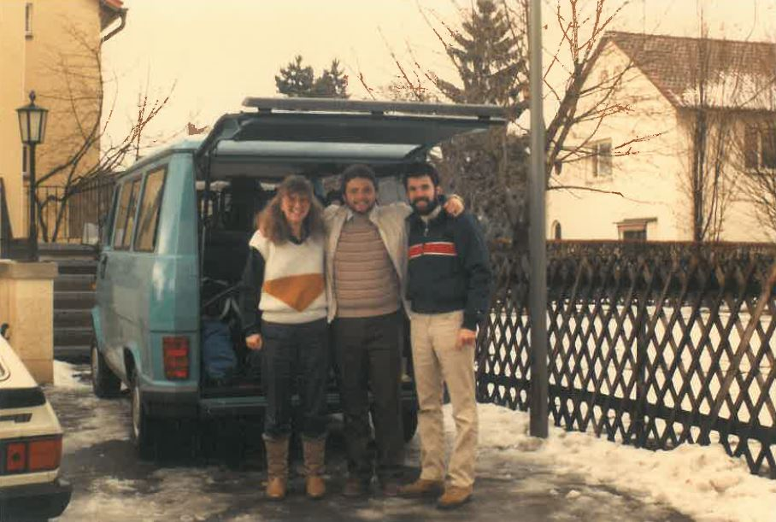

Slide 14
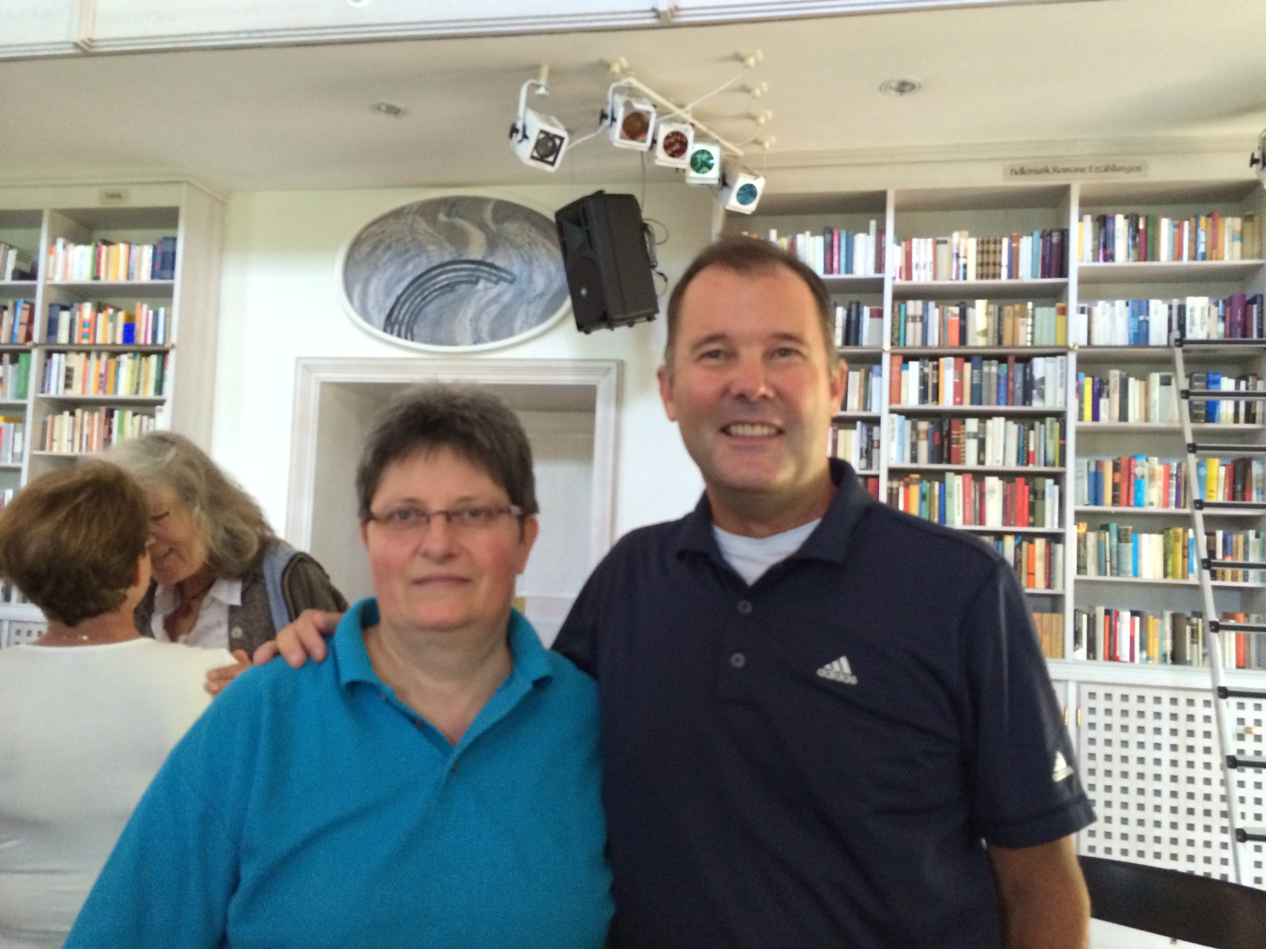

Slide 15
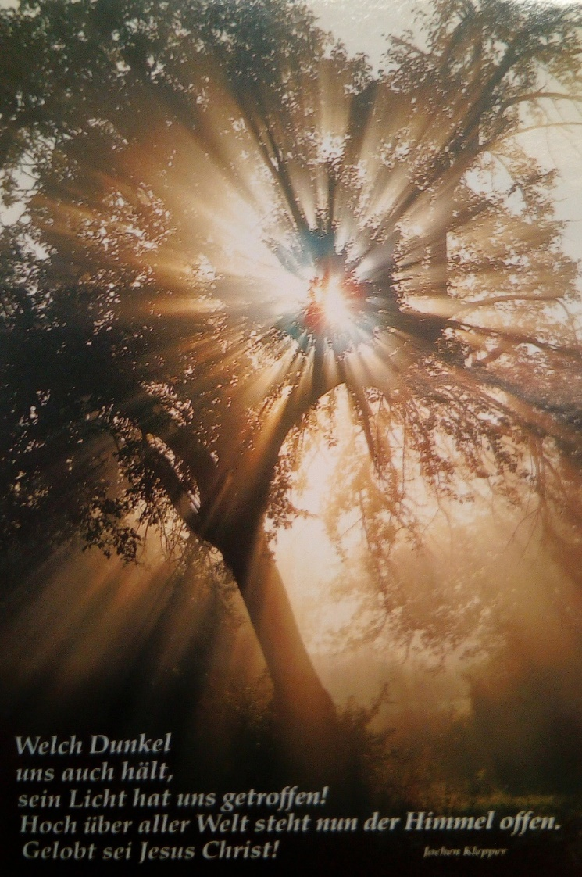

Slide 16
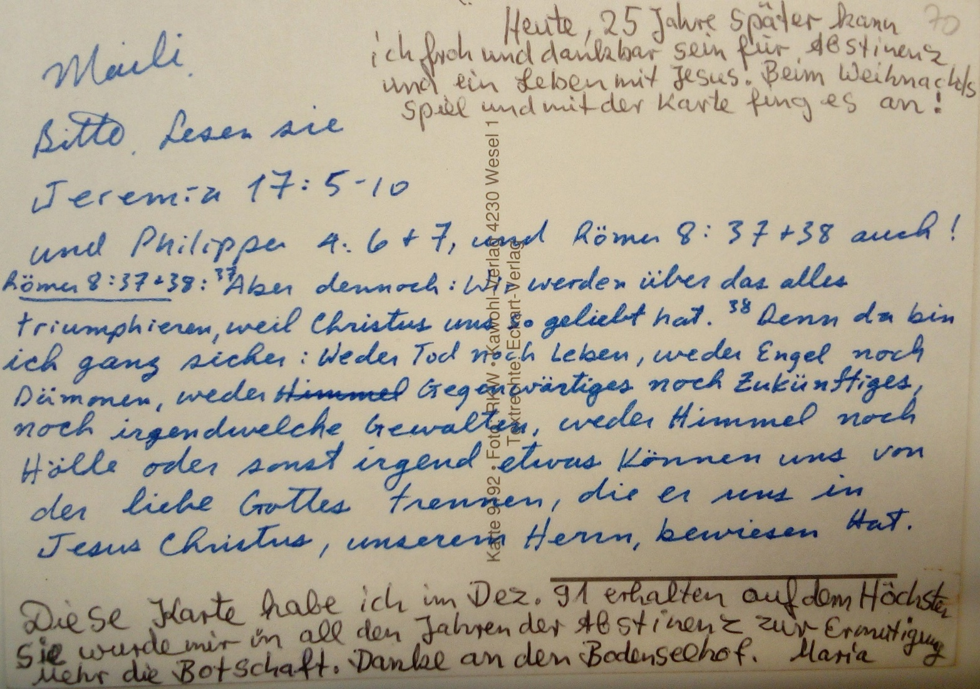

Slide 17
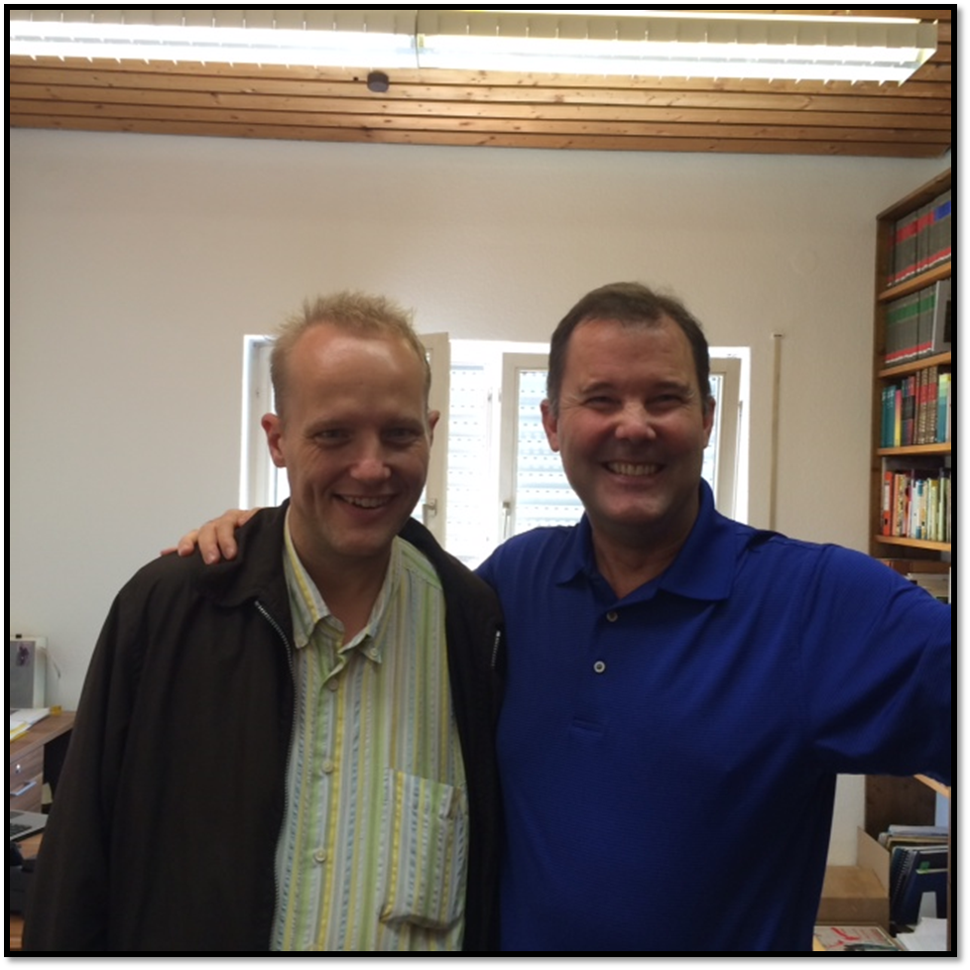

Slide 18
The Word Works!
God does what He says, always.

