Slide 2
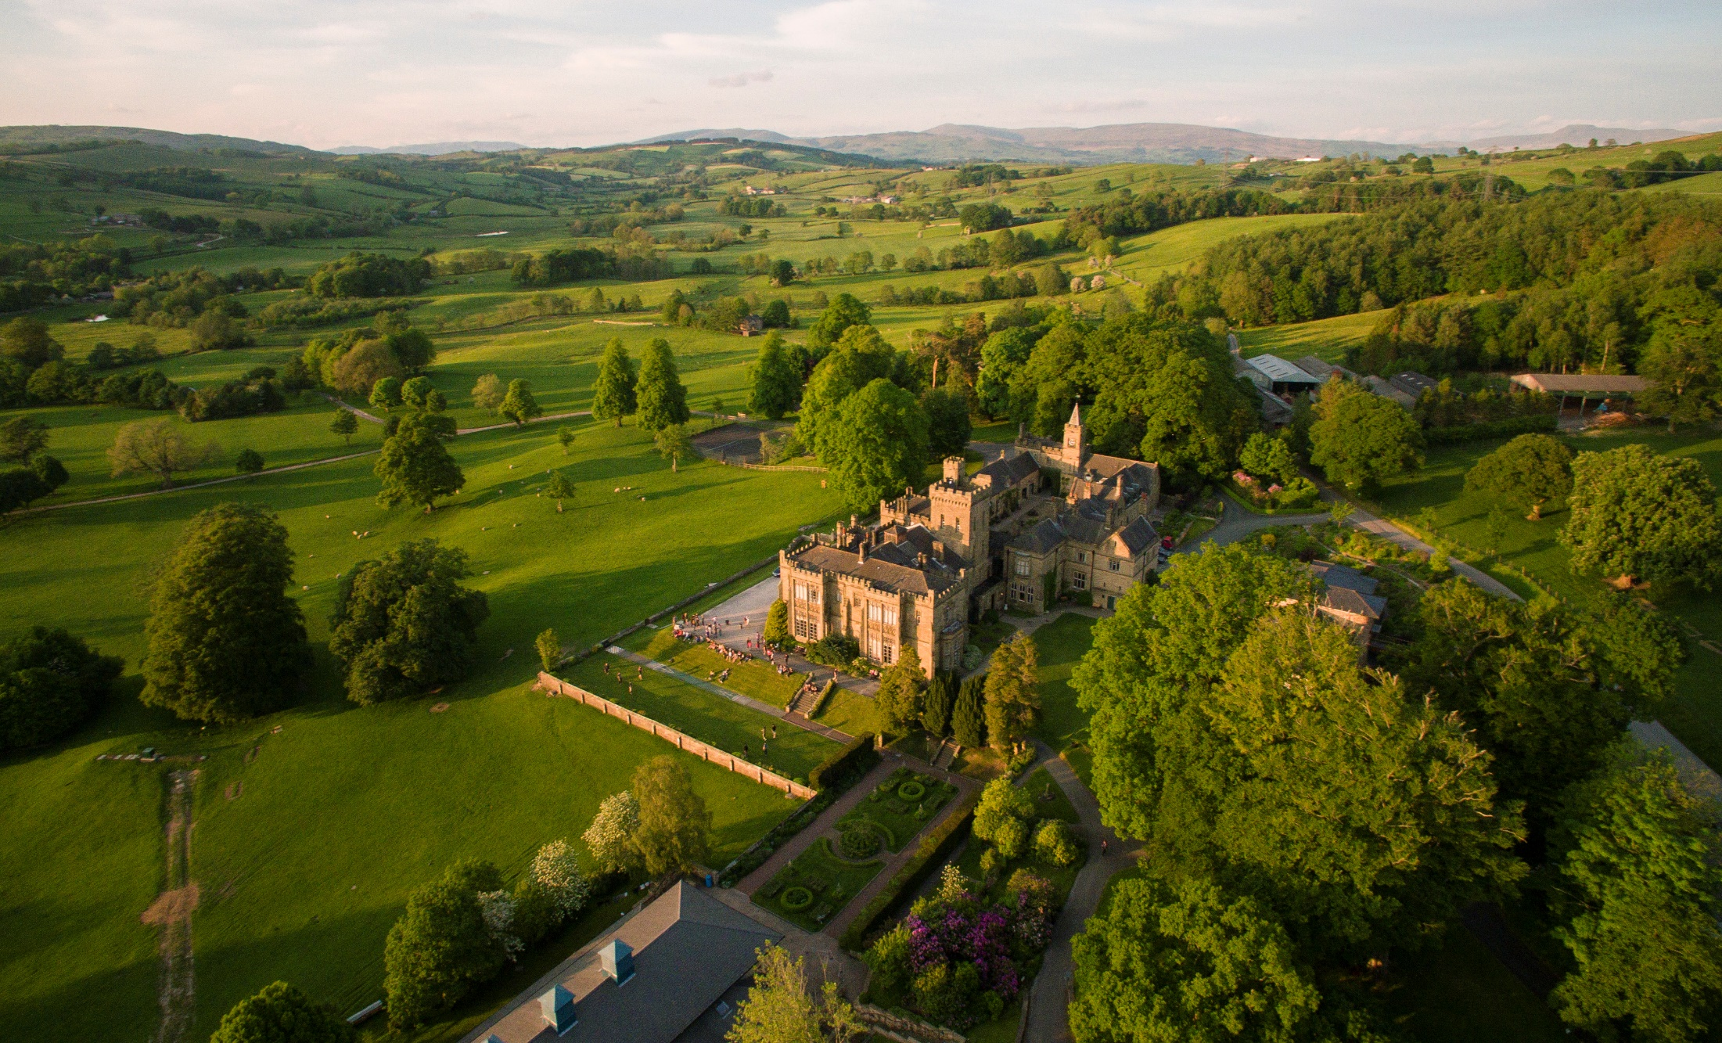

Slide 3
"It doesn't have to be possible it just has to be right, and God will make it possible."
Major Ian Thomas

Slide 4
