Slide 2
Pauls Sufferings
1:24

Slide 3
The Poem of God
“For we are His workmanship (Poem), created in Christ Jesus for good works, which God prepared beforehand so that we would walk in them.”
Eph. 2:10

Slide 4
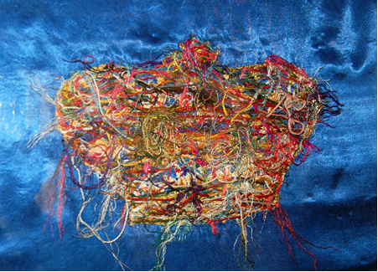

Slide 5


Slide 6
The Master never wastes His servant’s time.

Slide 7
“Today in the church we have a lot of emphasis on a therapy for suffering, but insufficient emphasis on a theology of suffering, which must form the basis of all therapy for suffering.”
Ajith Fernando
Acts 9:4; Phil. 1:13; Eph. 3:1

Slide 8
“Blessed be the God and Father of our Lord Jesus Christ, the Father of mercies and God of all comfort, who comforts us in all our affliction so that we will be able to comfort those who are in any affliction with the comfort with which we ourselves are comforted by God.” 2Cor. 1:3-4

Slide 9
"The power to help others lie in the acceptance of a trampled life."
Amy Carmichael

Slide 10
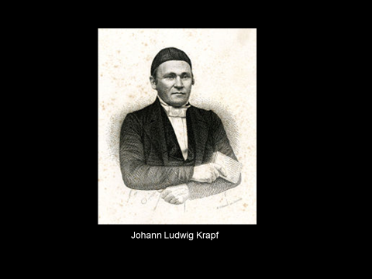

Slide 11

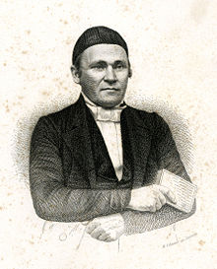
Johann Ludwig Krapf

Slide 12
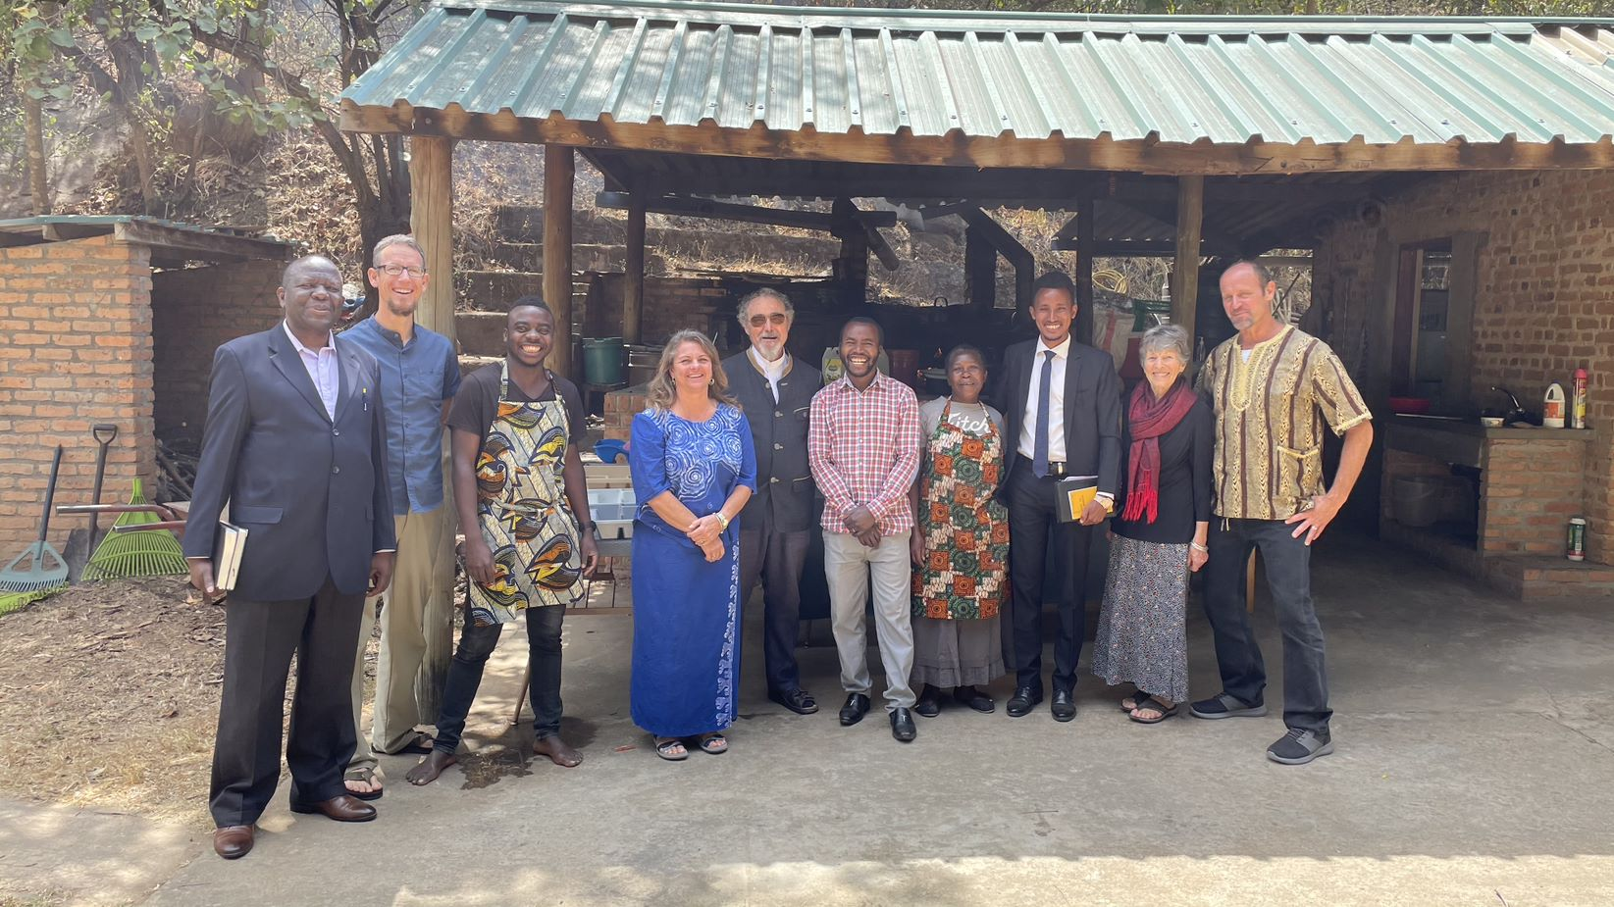
Johann Ludwig Krapf

Slide 13

Johann Ludwig Krapf

Slide 15
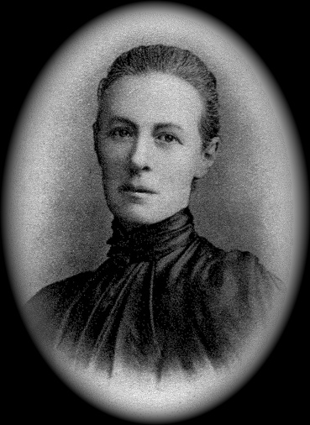

Slide 16
Take the very hardest thing in your life - the place of difficulty, outward or inward, and expect God to triumph gloriously in that very spot. Just there He can bring your soul into blossom.
Lilias Trotter

