Slide 2
Walking in Christ
2:1-7

Slide 3
Pauls Struggle
Vs. 1-5

Slide 4
It’s not all of Jesus and none of me, nor is it all of me and none of Jesus. It’s all of Jesus and all of me!

Slide 5
Pauls Teaching
Vs. 6-7

Slide 6
Circumstances are incidental to the Life of Christ within you.

Slide 7
Spiritual Responsibility is my response to His ability.
Gerhardt DuToit

Slide 8
As necessary as Jesus Christ is to become a Christian, so necessary is He to be the Christian you've become.

Slide 9
If you know how to become a Christian, you already know how to be the Christian you've become.

Slide 10
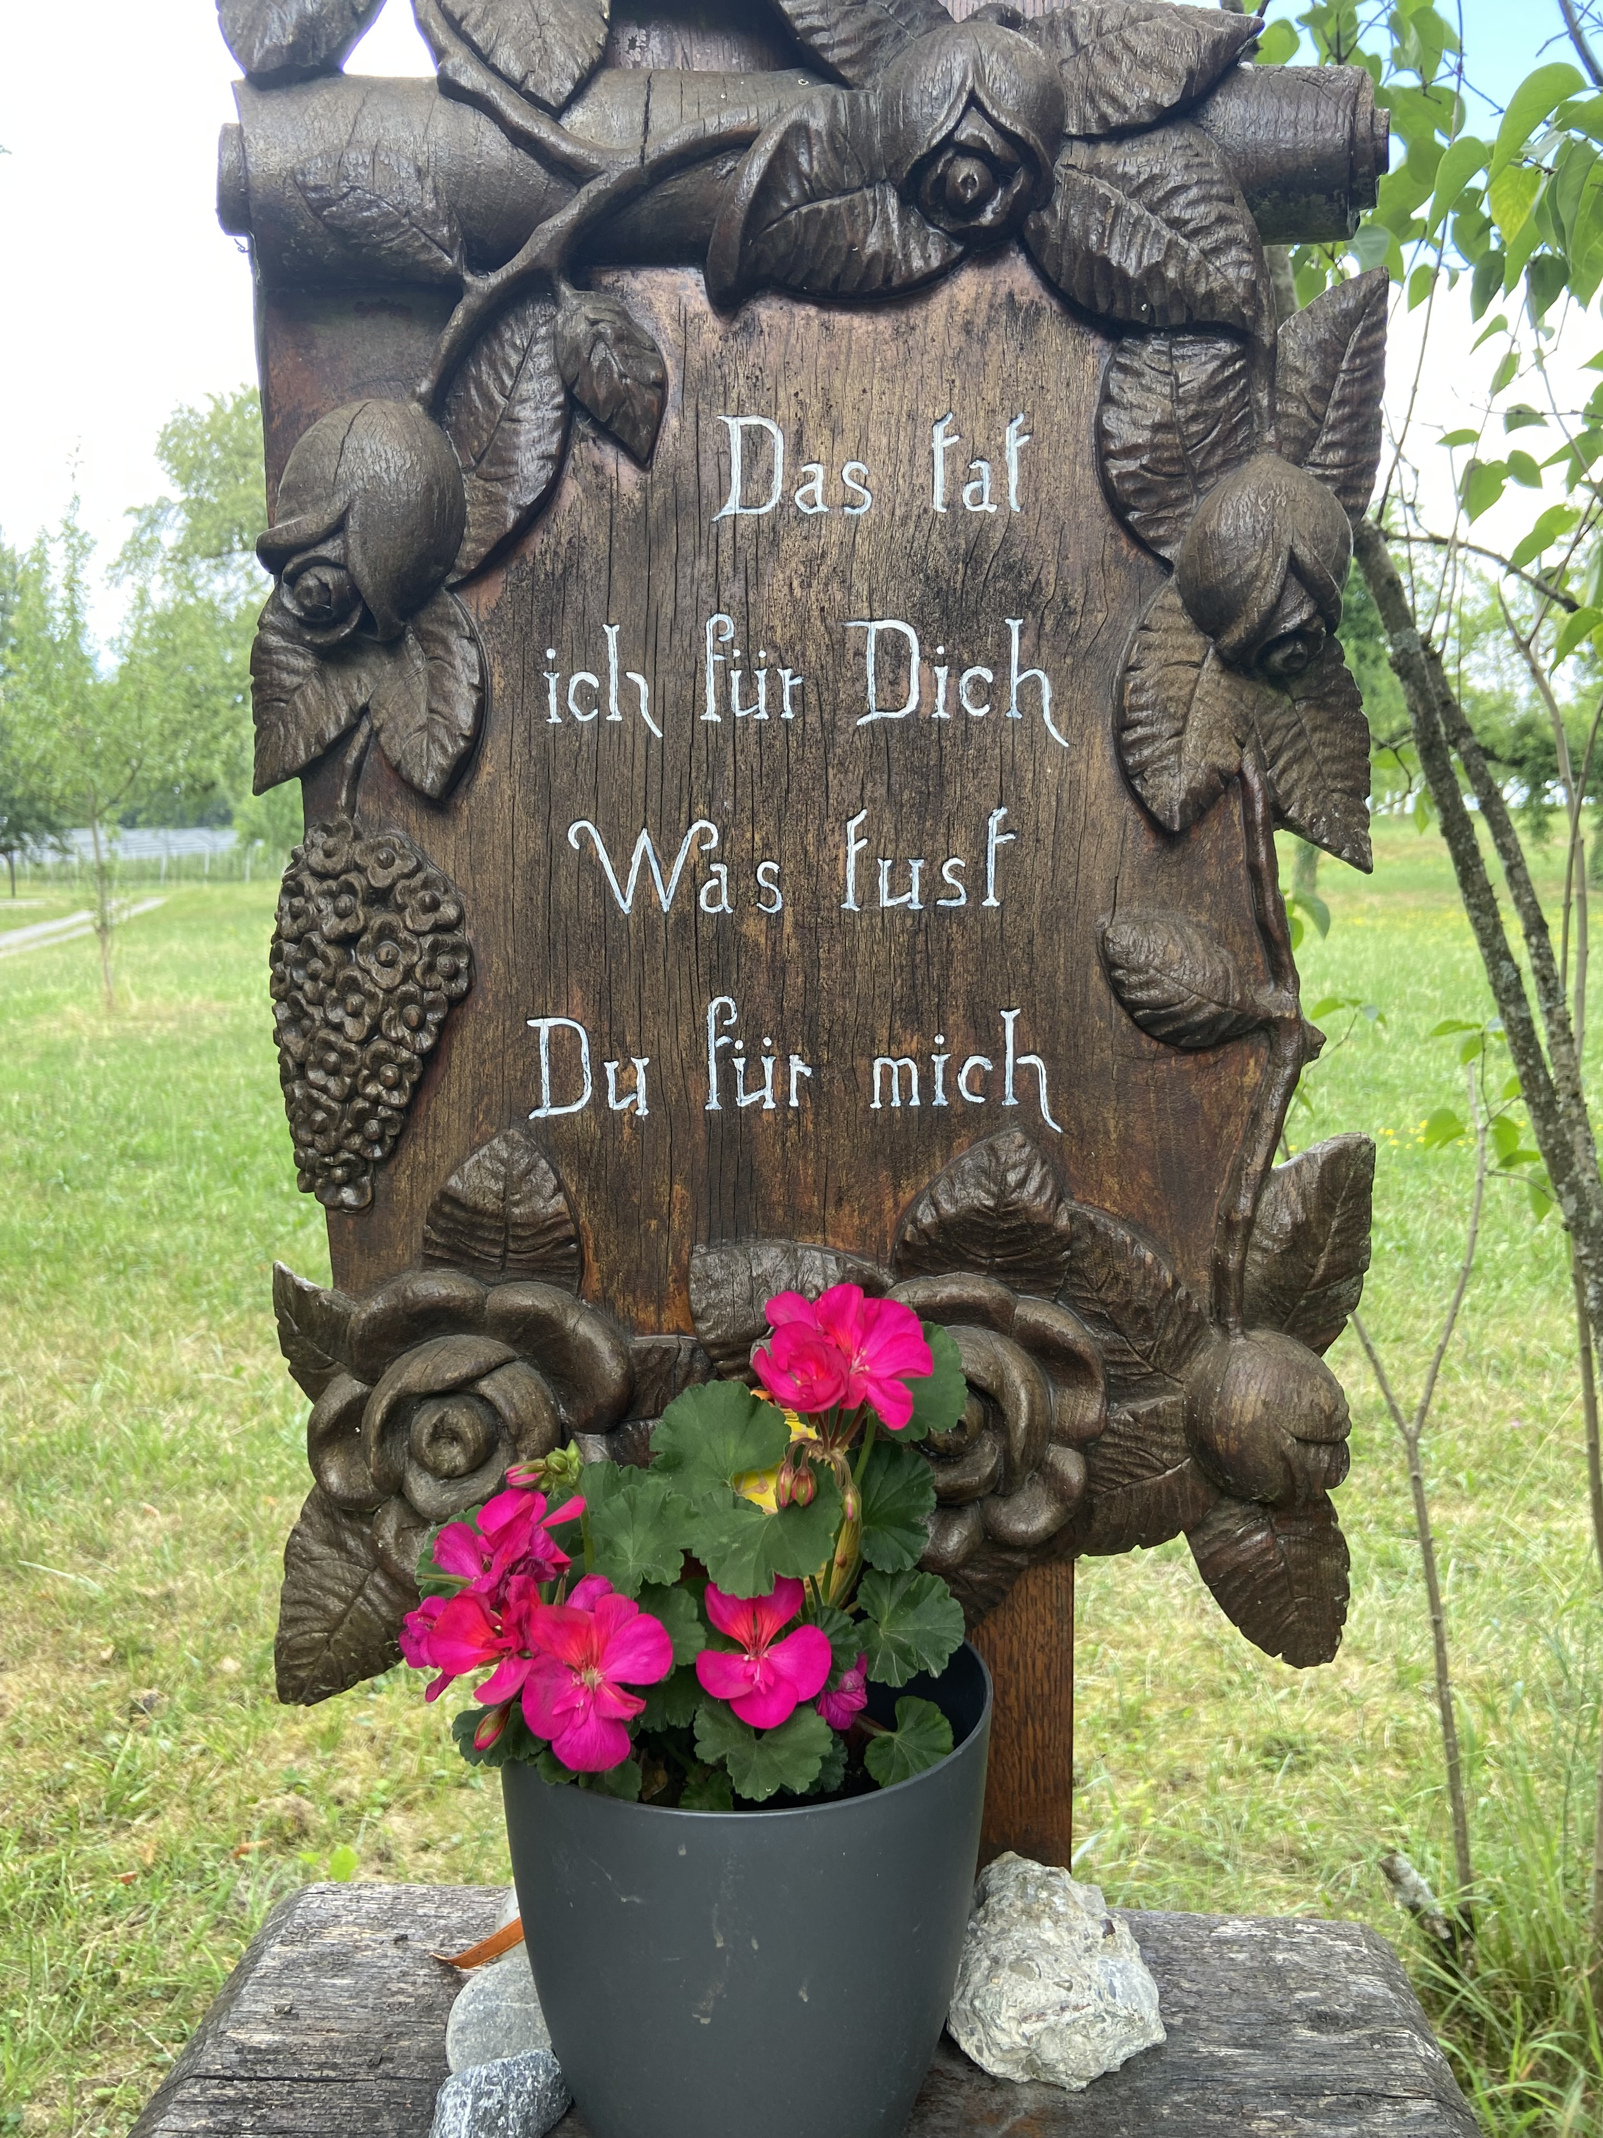

Slide 11
The time is fulfilled, and the kingdom of God is at hand; repent and believe in the gospel.
Mk 1:15

Slide 12
For this is the love of God, that we keep His commandments; and His commandments are not burdensome.
1Jn. 5:3

Slide 13
Repentance
Change your mind.

Slide 14
“The meek man is not a human mouse afflicted with a sense of his own inferiority…he has stopped being fooled about himself. He has accepted God estimate of his own life.”
A.W. Tozer

Slide 15
The link between Repentance and Faith.
Lk. 7:29-30; Rom. 8:3; Rom. 14:23

Slide 16
The effectiveness of our faith depends on the repentance which precedes it.

Slide 17
Faith
Faith is the attitude which allows someone else to do something for you!
Heb. 12:2; Jn. 17:17; Rom. 10:17; Rom. 10:10
2Tim. 2:13; Rom. 9:33; 2Cor. 5:7

Slide 18
“If I had known earlier that the tiny palace of my soul accommodates such a great king, I would never have left Him alone there so often.”
Theresa from Avila

Slide 19
Walk!
1. Take one step at a time.
2. Repeat the same motion.
3. What is unnatural becomes habit.
4. When you fall, get up!
Jer. 8:4; Prov. 24:16; Phil. 3:16; Ps. 130:4

Slide 20
Grace teaches us not to sin, not the law.
The law teaches us that we can’t stop sinning.
Titus 2:11-12

Slide 21
It’s my ability to receive that keeps me alive physically and spiritually.

Slide 22
God’s greatest saints are His best receivers.
The secret of God’s relationship to man is that He is the Giver; hence the secret of man’s relationship to God is that he is the receiver.

