Slide 2
Colossians

Slide 3
Made Usable
Col. 1:1-2

Slide 4
Timing
Gal. 1:11-18
(Jer. 1:5; Rom. 14:7-9; Is. 53:2; Phil. 3:8)

Slide 5
Circumstances are incidental to the life of Christ within you.

Slide 6
Commission
Acts 13:1-4,9
(Ps. 102:23)

Slide 7
Sent!
Someone else initiates their activity in your life.
Someone else takes responsibility for that which they initiate.

Slide 8
"The initiative for opening doors of service is never ours but His... consequently the true source of inspiration for service is always behind me and never in front of me. The challenge will always be in front of me, as well as the means."
Alan Redpath

Slide 9
Ministry:
Go where you’re sent.
Stay where you’re put.
Do what you’re told.
Repeat what you’ve heard.
Leave when you’re done.
(Job 14:5)

Slide 10
Scars (Col. 4:18)
"It is doubtful whether God can use a man greatly until He was hurt him deeply."
“Never follow a leader who doesn’t limp.”
A.W. Tozer
(1Cor. 16:21; Gal. 6:11; 2Thess. 3:17; Gal. 4:13-15)

Slide 11
“Mein Leben ist nicht der Rede wert.”
My life is not worth mentioning.
Acts 20:24

Slide 12
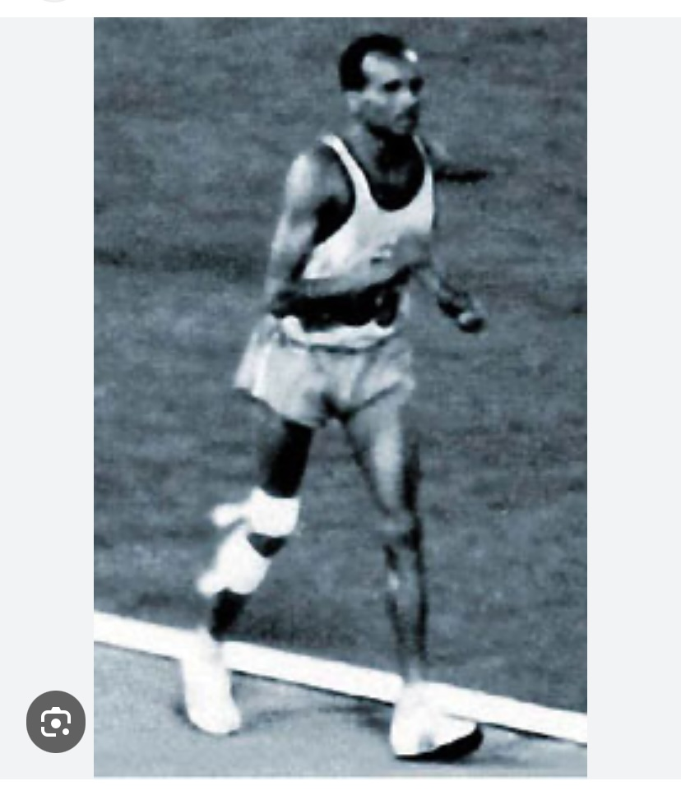

Slide 13
“My country did not send me 5,000 miles to start the race, they sent me 5,000 miles to finish the race.” John Stephen Akhwari of Tanzania who finished last in the Olympic Marathon in Mexico City in 1968.

Slide 14
“The ‘romance’ of a missionary is often made up of monotony and drudgery; there often is no glamour in it; it doesn’t stir a man’s spirit or blood. So don’t come out to be a missionary as an experiment; it is useless and dangerous. Only come if you feel you would rather die than not come. Don’t come if you want to make a great name or want to live long. Come if you feel there is no greater honor, after living for Christ, than to die for Him.”
C.T. Studd

Slide 15
"Fulfill your service with this goal in mind, and that is to make your service unnecessary. Give what you have and then leave those you serve with their Lord. It is the Lord who gives through you. Connect them directly to Christ, and then hide yourself in the glory of his divine shadow and disappear like Philip before the eunuch. They need the living Christ, not you."
Otto Stockmayer

