Slide 1
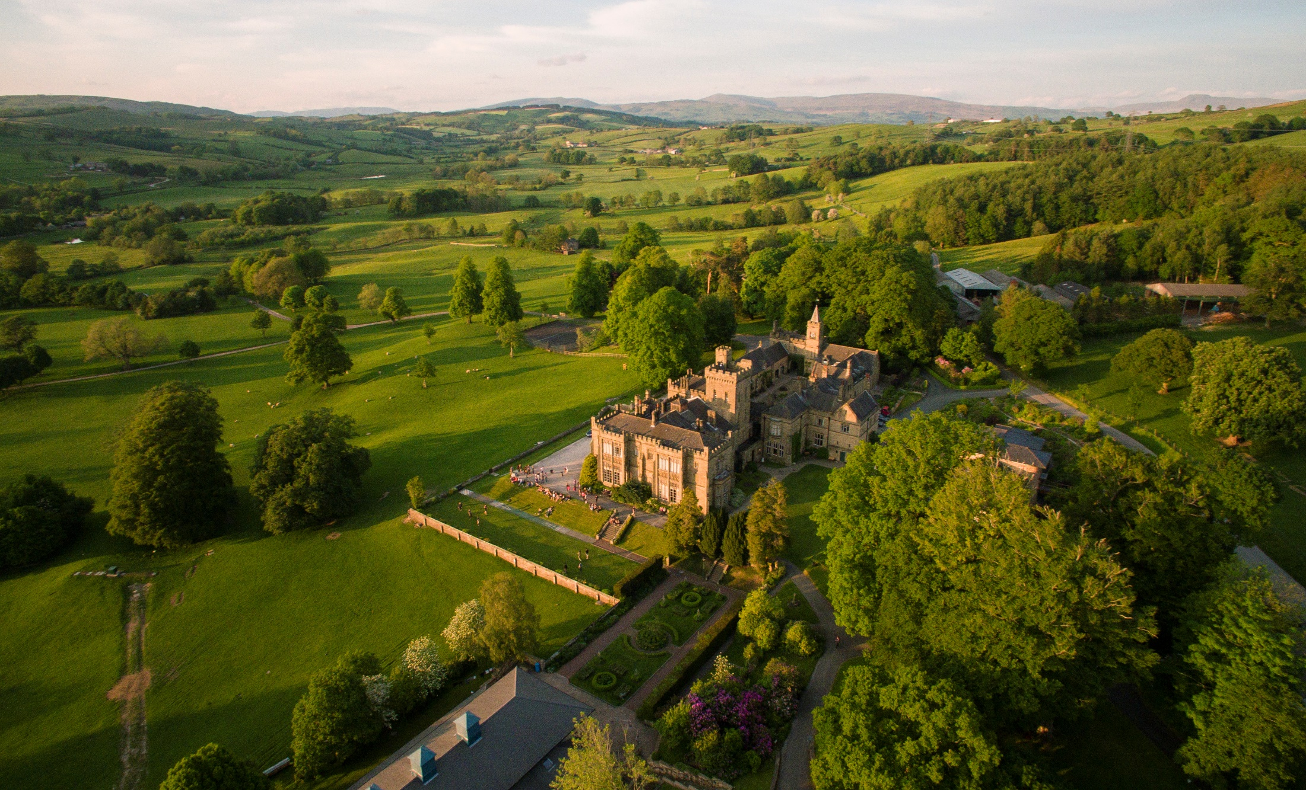

Slide 2
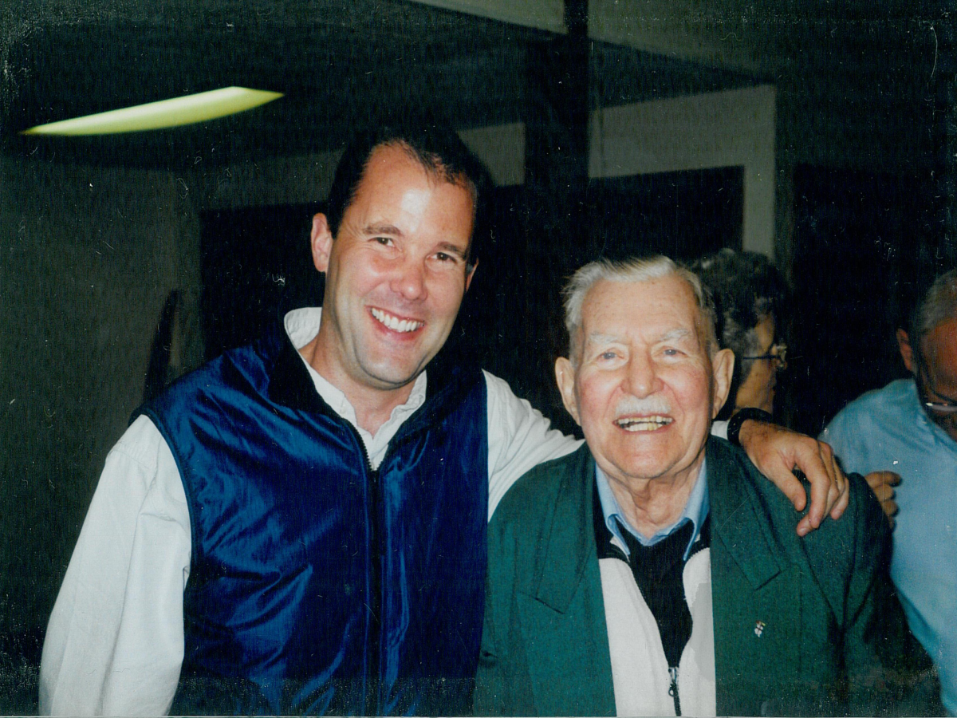
"It doesn't have to be possible it just has to be right, and God will make it possible."
Major Ian Thomas

