Slide 1

The Heart of Our Savior

Slide 2
Points of Interest
~ In the Gospel of John ~

Slide 3

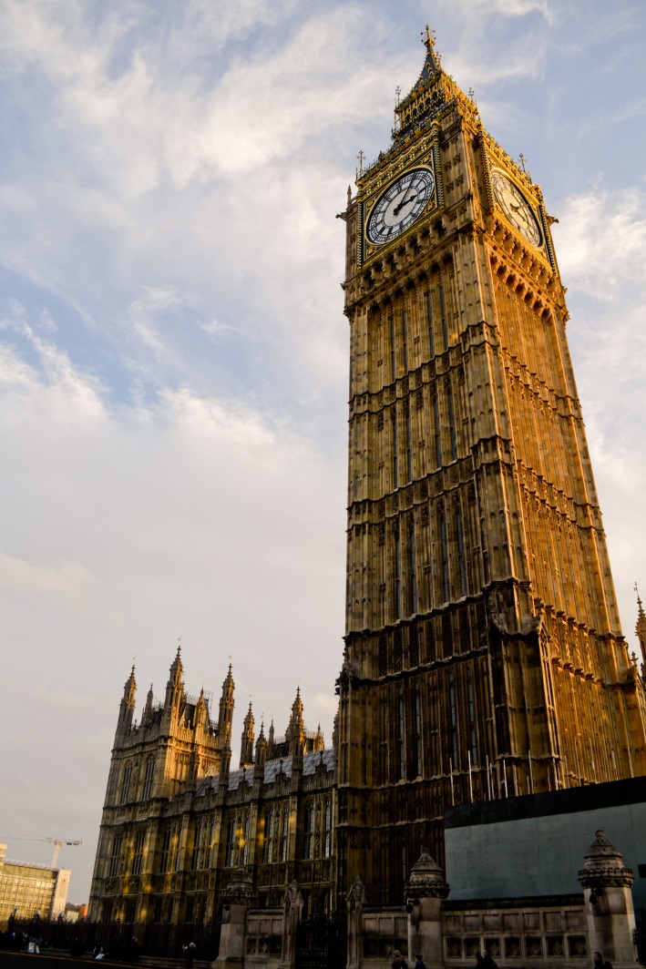
Spiritual Background
The Traditions of the Elders (Mishna, Talmud)
The Synagogue
The Scribes
The Pharisees
The Sadducees
The Sanhedrin
The Common Man

Slide 4
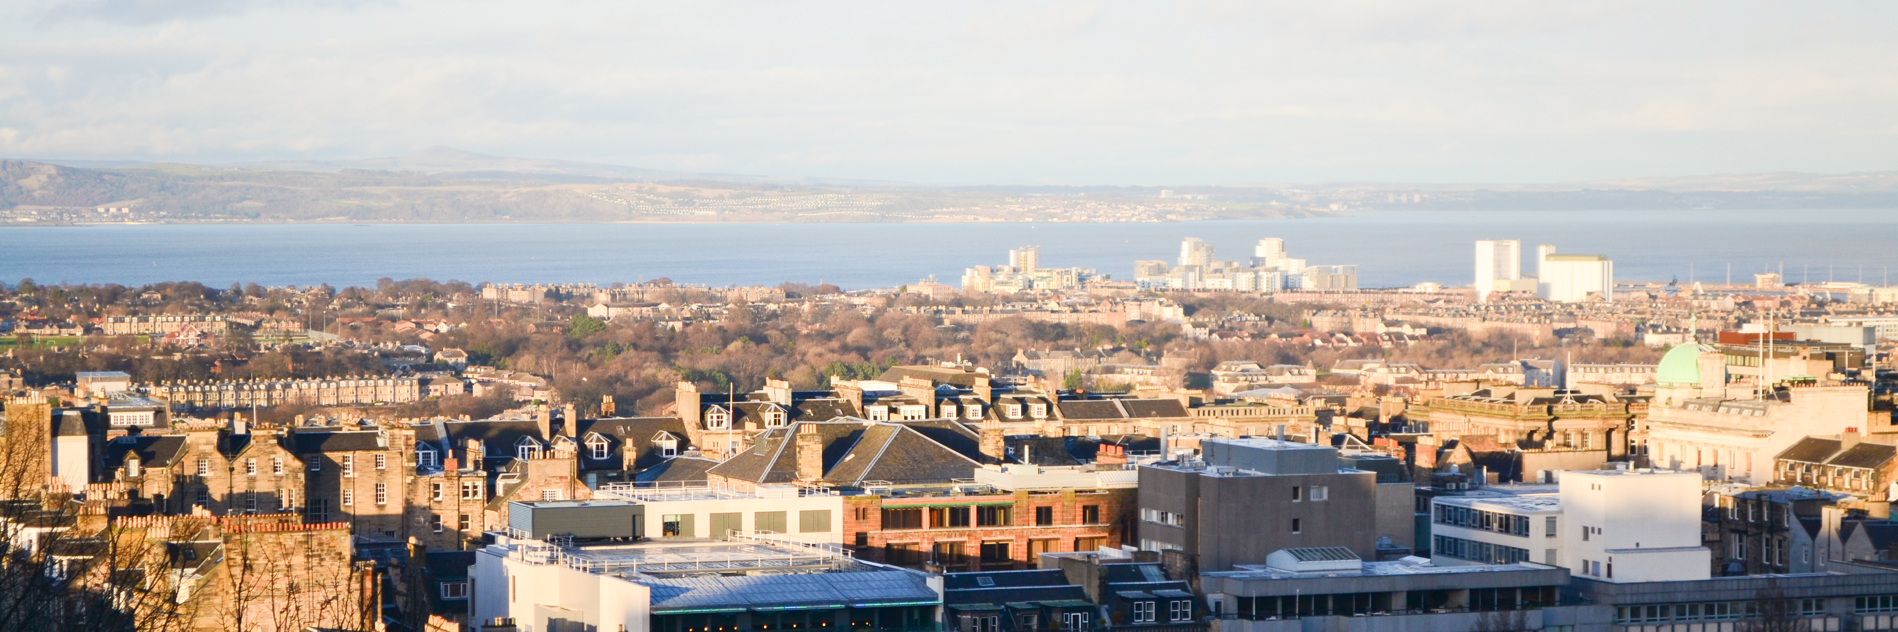
Uniqueness of Material
Relation to Synoptics
Time Proportions

Slide 5

Insights into the Apostle John

Slide 6
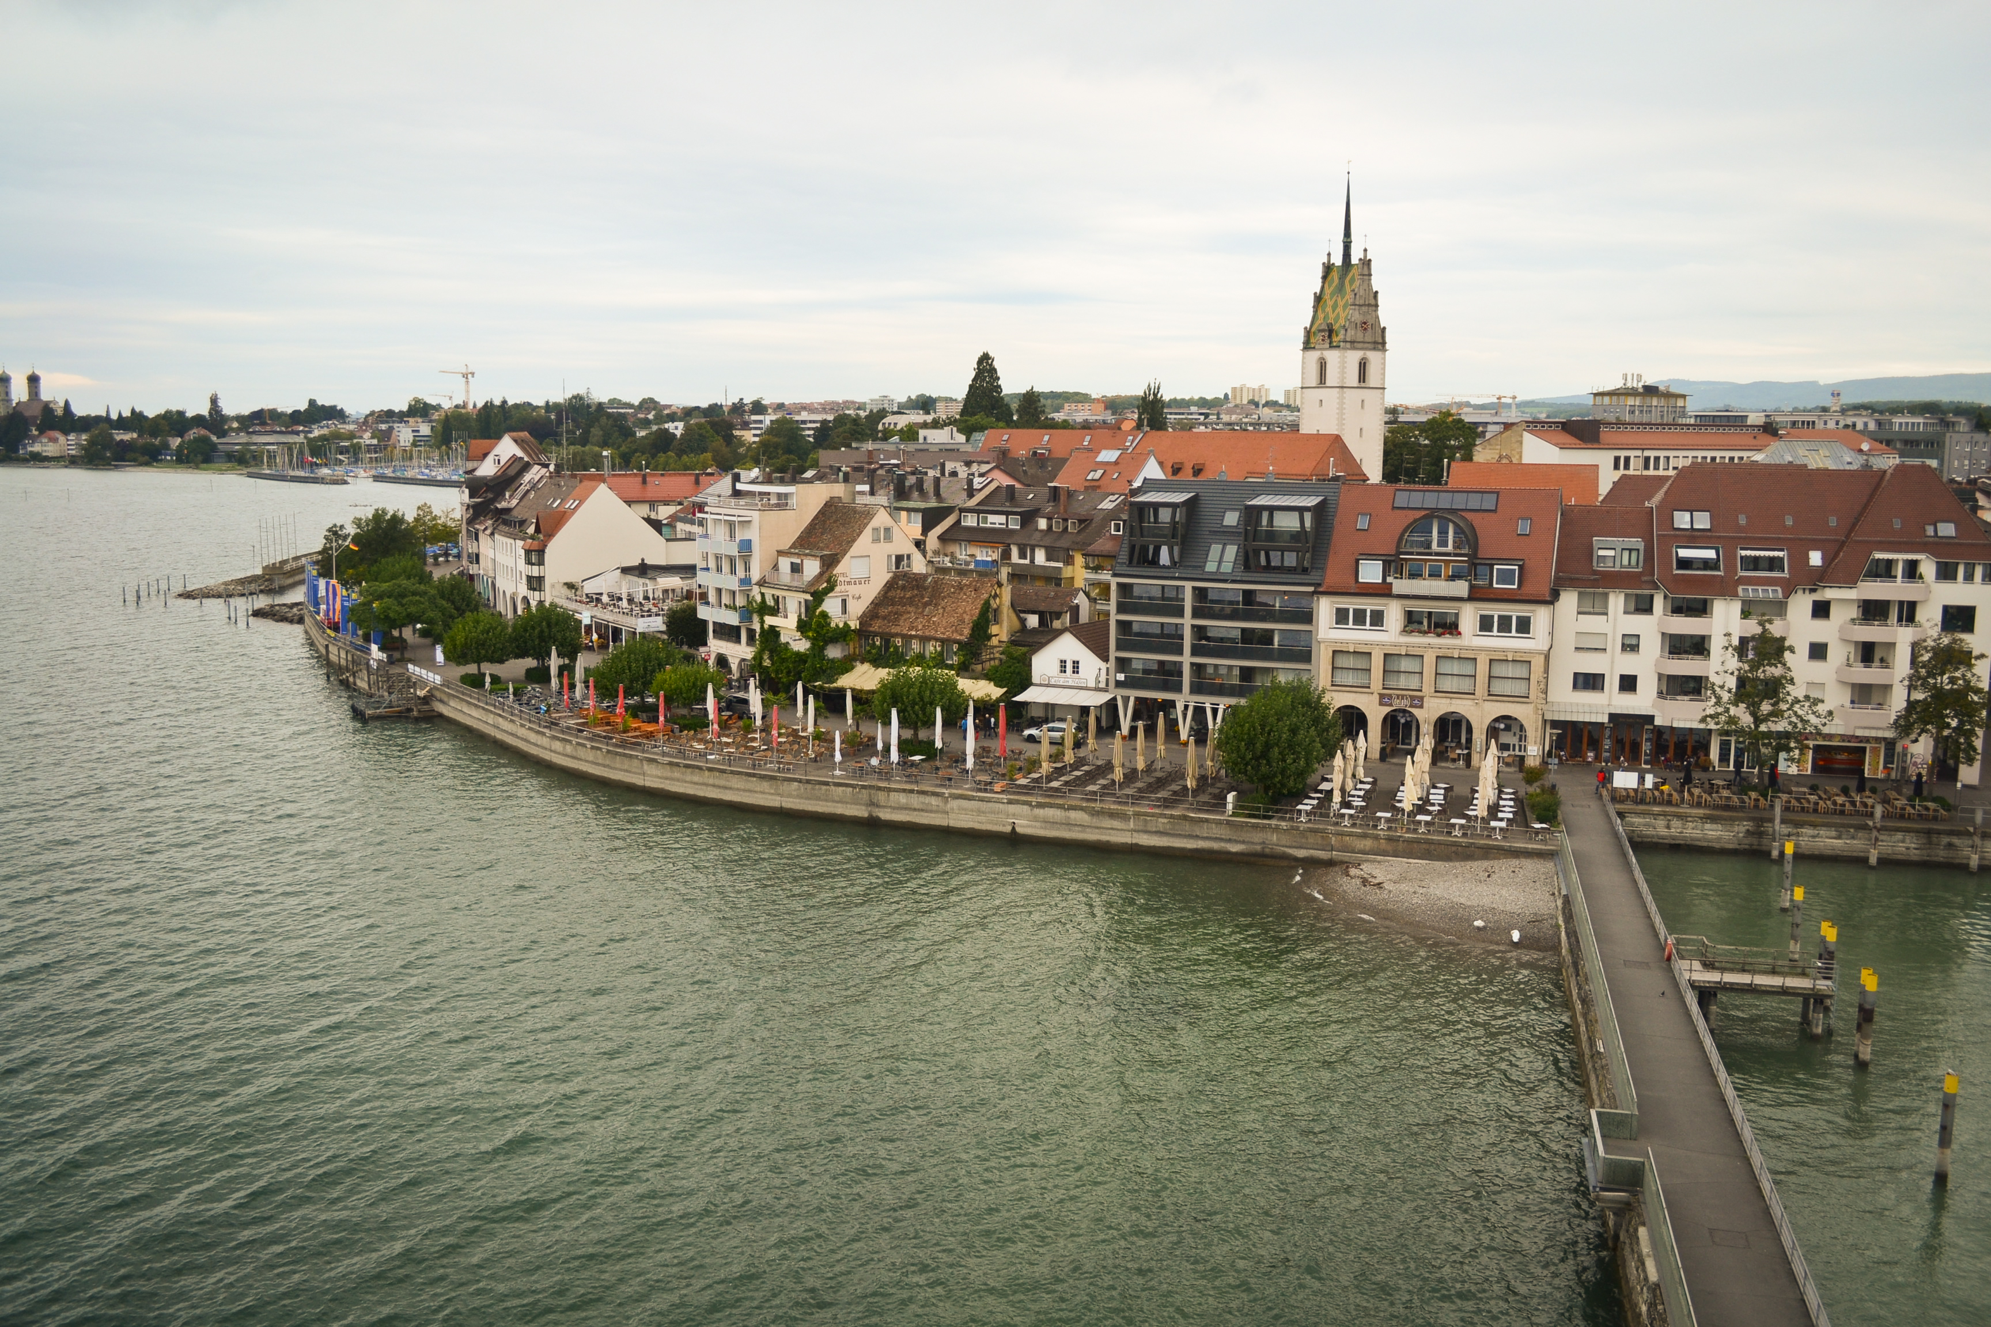
His Family Background

Slide 7

His Character and Temperament
Lk. 9:46-56; Matt. 20:20-28; 1Sam. 16:7;
Ps. 25:14

Slide 8

His Transformation
Jn. 13:23; 19:26; 20:2; 21:7; 21:20
Pray: Eph. 3:14-19
1Jn. 4:19 “He loved us first”

