Slide 1
The Upper Room Discourse
Jn. 13-17

Slide 2
The last times of the church:
Matt. 24:4-14

Slide 3
God was still on the throne
His triumphal entry into Jerusalem was foretold. (Zech. 9:9; Ps. 118)
He would be smitten as a shepherd (Zech. 13)
He would be betrayed for 30 pieces of silver (Zech. 11:1-13; Ps. 41:9)
He would be given vinegar and gall to drink (Ps. 69:21)
They would cast lots for His garments (Ps. 22:18)
His bones would not be broken (Ex. 12:46; Numb. 9:12; Ps. 34:20)

Slide 4
God was still on the throne
His side would be pierced (Zech. 12:10; Ps. 22:16)
He would die with transgressors (Is. 53:9,12)
His dying words for foretold (Ps. 22:1,31)
He would be buried by a rich man (Is. 53:9)
He would rise on the third day (Jonah 1:17; Mat. 12:39-40)
His resurrection is followed by the destruction of Jerusalem
(Dan. 9,11,12; Lk. 19:41-44)

Slide 5
Pastor Jesus:
13:19; 15:11; 16:1-2; 16:33

Slide 6
Christian Courage Jn. 14:1-12

Slide 7
Courage for our future
Vs. 1-6

Slide 8
“If you read history, you will find that the Christians who did most for the present world were just those who thought most of the next…It is since Christians have largely ceased to think of the other world that they have become so ineffective in this one. Aim at Heaven and you will get earth ‘thrown in’; aim at earth and you will get neither.”
C.S. Lewis

Slide 9
“Hearts on earth may say in the course of a joyful experience, ‘I don’t want this to end.’ But invariably it does. The hearts of those in heaven say, ‘I want this to go on forever.’ And it will. There is no better news than this.”
J.I. Packer

Slide 10
I am the way
Acts 4:12

Slide 11
I am the truth
Heb. 1:1-3

Slide 12
I am the life
Eph. 4:18; Eph. 2:4-5

Slide 13
Courage for today
Vs. 7-12

Slide 14
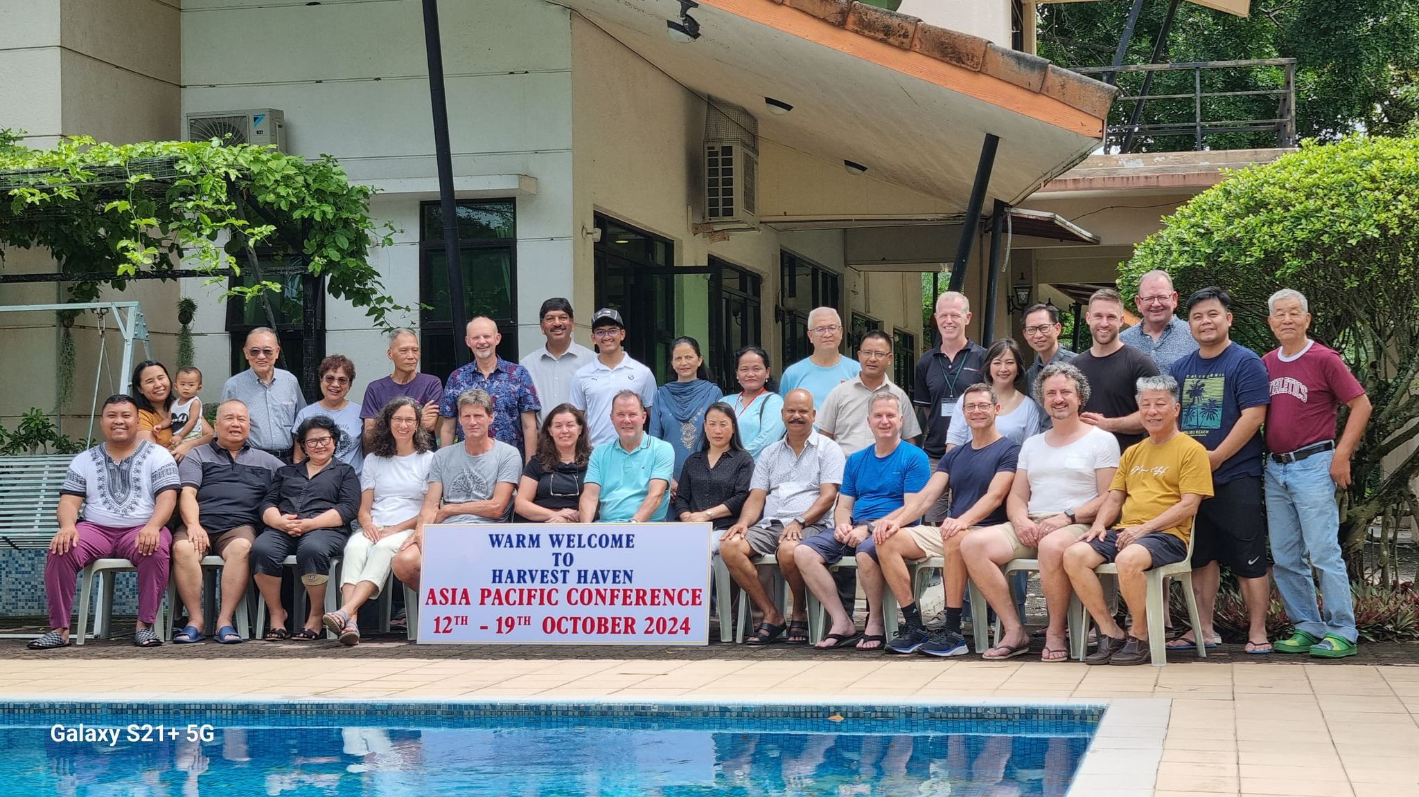
The Kindness of God

Slide 15
Biographies:
H. Taylor, J.O. Fraser, R. Moffet, A. Carmichael, L. Trotter, G. Aylward, C.H. Spurgeon
German: Franke, Blumhardt, Hofacker, Stockmayer; Krapf

