Slide 1
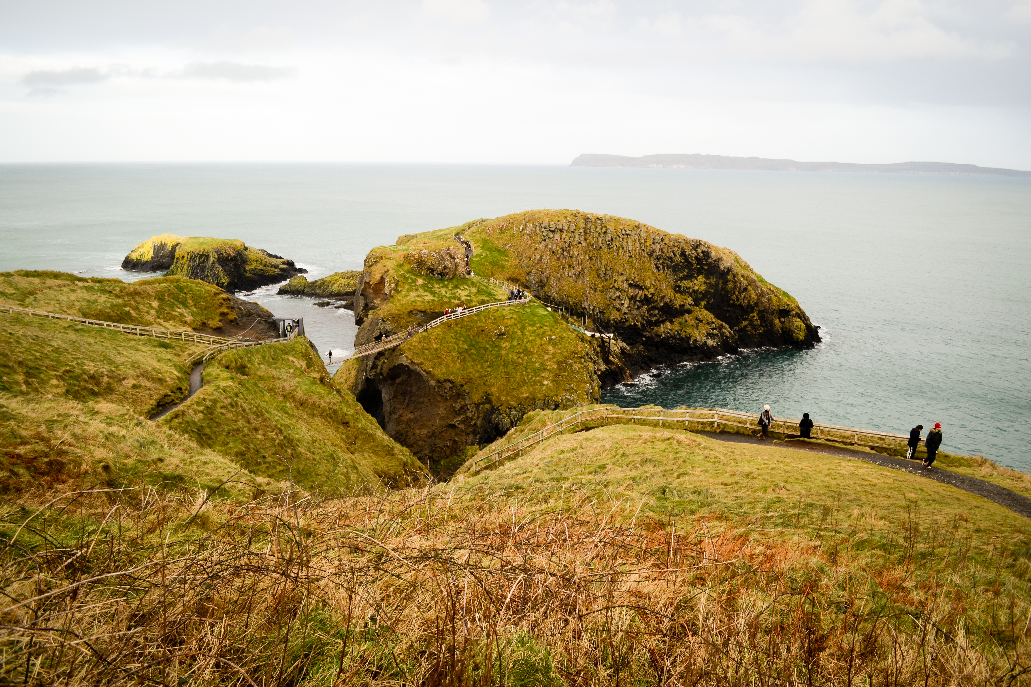
Christ’s Arrest, Trials and Crucifixion
~ Jn. 18-19 ~

Slide 2

The Arrest of Christ: 18:1-11
The Trial Before Annas: 18:12-24
The Trial Before Caiaphas:
18:25-27 (Mk. 14:53-65)
The Trial Before the Sanhedrin:
Lk. 22:66-71

Slide 3
The First Trial Before Pilate: 18:28-40
The Trial Before Herod: Lk. 23:6-12

Slide 4
The seven declarations of Christ’s innocence:

Slide 5
Mat. 27:4 Judas declares Jesus innocent
Lk. 23:14 (Jn. 18:38, 19:4,6) Pilate declares Jesus innocent (3X!)
Lk. 23:15 Herod declares Jesus innocent
Mat. 27:19 Pilates wife declares Jesus innocent
Lk. 23:41 The dying thief declares Jesus innocent
Lk. 23:47 The Roman soldier declares Jesus innocent
2Cor. 5:21 Paul declares Jesus innocent

Slide 6
The Second Trial Before Pilate: 19:1-16
The Crucifixion of Christ: 19:17-30

Slide 7
The words of Christ from the cross.

Slide 8
“Father, forgive them, for they know not what they do.“ Lk. 23:34
„Today you will be with Me in Paradise.“ Lk. 23:43
„Woman, behold your son... Behold your mother.“ Jn. 19:27

Slide 9
„My God, My God, why have you forsaken Me.“ Mat. 27:46; Mk. 15:34
„I am thirsty“. Jn. 19:28
„It is finished.“ Jn. 19:30
„Father, into Your hands I commit My spirit.“ Lk. 23:46

Slide 10
The Burial of Christ: 19:31-42

