Slide 1

The Meaning of the Resurrection

Slide 2
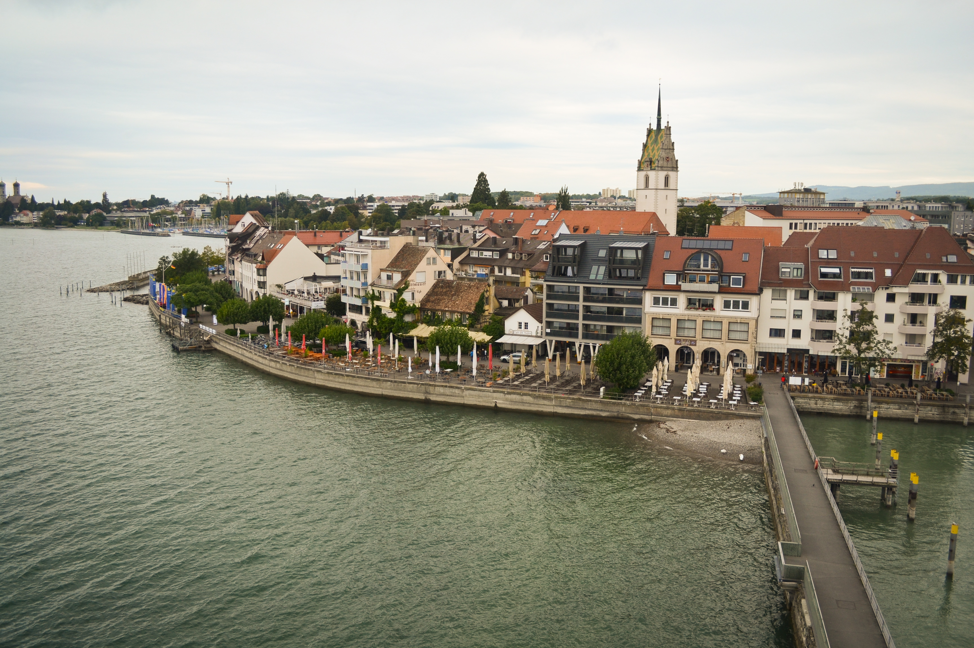
The resurrection confirms the truth of His word.
Matt. 16:21; 28:4-5

Slide 3
The resurrection relieves us from the fear of death.
1Cor. 15:54-58; Rev. 1:17-18;
Heb. 2:14-15

Slide 4
The resurrection gives us hope for our own resurrection.
Ps. 116:15; Matt. 27:52-53; Rom. 8:22-25; 2Cor. 5:4

Slide 5
The resurrection demonstrates the power of His Spirit in us.
Rom. 8:11; 1Pet. 1:3-5

Slide 6
40 Days
Acts 1:3

