Slide 1

The First Disciples
Jn. 1:35-51

Slide 2

“Hell itself is truth known too late. Be wise in time. What youth sows, old age must reap. Do not give the most precious season of your life to that which will not comfort you in the latter days of your life.”
J.C. Ryle

Slide 3
Jesus is the Wonderful Counselor
Is. 9:6
Jesus understands our circumstances
Jesus understands our secrets
Jesus understands our weakness

Slide 4
Discipleship: Learning to remain dependent on Jesus at all costs.

Slide 5


The First Disciples Jn. 1:35-51
John the Baptist: vs. 35-37
Andrew: vs. 38-39
Peter: vs. 40-42
Philip: vs. 43-46
Nathanael: vs. 47-51

Slide 6
"Fulfill your service with this goal in mind, and that is to make your service unnecessary. Give what you have and then leave those you serve with their Lord. It is the Lord who gives through you. Connect them directly to Christ, and then hide yourself in the glory of his divine shadow and disappear like Philip before the eunuch. They need the living Christ, not you."
Otto Stockmayer

Slide 7

Andrew v. 38-39
4. The invitation to the man to stretch out his withered hand. Lk. 6:8
5. The invitation to Zaccheus to come down out of the tree. Lk. 19:5
6. The invitation to Andrew to come and stay with Jesus. Jn. 1:39
7. The invitation to the disciples of come and have breakfast on the beach.
Jn. 21:12
„Come...“
1. The invitation to Peter to come to Him on the water. Mat. 14:29
2. The invitation to the rich young ruler to come and follow Him. Mat. 19:21
3. The invitation to the disciples to come away to a lonely place to rest. Mk. 6:31

Slide 8
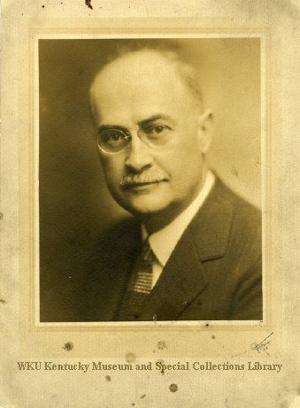
Sept. 1934: „Revival Meeting. Charlotte, North Carolina, failure. Nothing happened. Only one 16 year old was saved. Billy Graham was his name.“

Slide 9
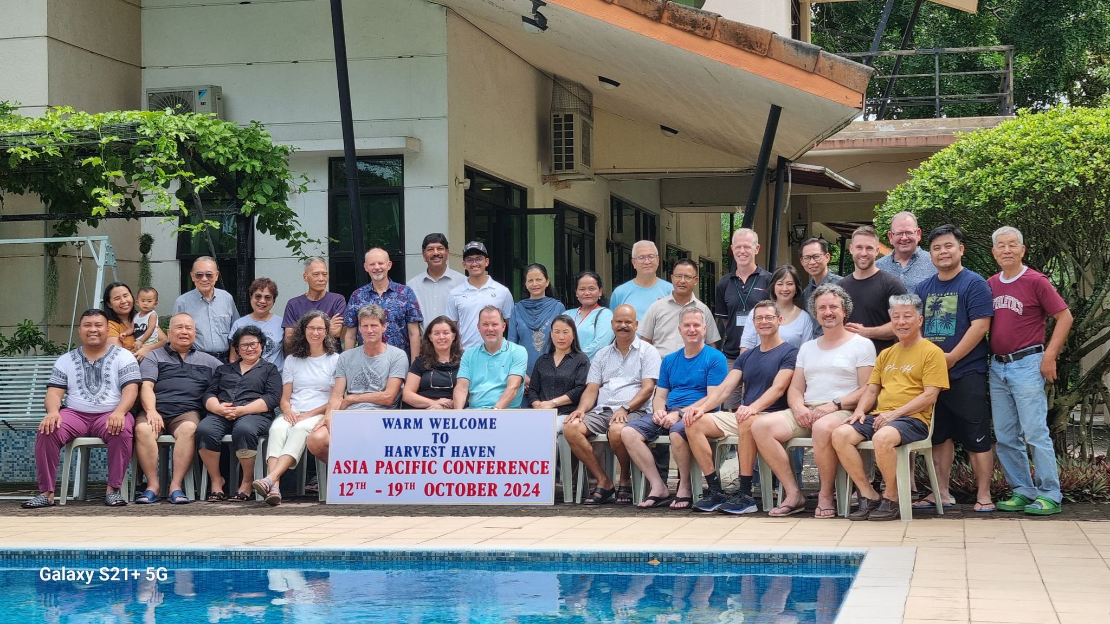
The Kindness of God

Slide 10
Peter vs. 40-42
He wrote two books of the NT
He dictated the events in the 2nd gospel account to Mark.
Gal. 2:9: He was reputed to be a pillar of the church.
Traditions holds he was martyred in Rome.

Slide 11
Philip vs. 43-46
„Follow Me“
Jn. 1:43 - Philip
Mat. 4:19 - Peter and Andrew
Mat. 8:22 - The disciple who wanted to bury his father
Mat. 9:9 - Matthew
Mat. 19:21 - The rich young ruler
Jn. 21:19,22 - Peter

Slide 12
“God takes nothing from you but that which He will supply with His own presence.”
Samuel Rutherford

Slide 13
Nathanael vs. 47-51
Be Merciful - Mat. 7:1-2
Not everyone is a hypocrite
Sin is not necessarily hypocrisy
Jesus rebuked hypocrites, He invited sinners
Our faith is placed in Christ, not Christians
The churches failure is not Christ‘s failure

Slide 14

We cannot franchise Jesus
His teaching fits my capacity to learn
Conclusions
Jesus is bigger than our experience
Respect the diversity amidst our unity

