Slide 2
The Gospel of Life
Jn. 3:1-8

Slide 3
Problems and Symptoms:
Eph. 4:18; Eph. 2:4-5

Slide 4
The Man: Jn. 3:1-3
It’s possible to know the word of God without knowing the God of the word.
It’s possible to be among Gods children without being one of Gods children.

Slide 5
Righteous Intolerance
Rom. 8:9; 1Jn. 5:12

Slide 6
The Miracle: Jn. 3:4-6
Heaven is not the offer of the gospel. Eternal life is the offer of the gospel.
Eternal life is not a place we enter after we die; eternal life is a Person who enters us before we die.
Eternal life begins at faith, not death.

Slide 7
“As the kings of the earth and the mighty men of the earth are born in exactly the same way physically as the simplest man, so the most intellectual person must become a Christian in exactly the same as the simplest person. This is true for all men everywhere, through all space and time. There are no exceptions.”
Francis Schaeffer
Jn. 1:12-13

Slide 8
Jn. 3:7-8
Visibility is not the last measure of reality.

Slide 9
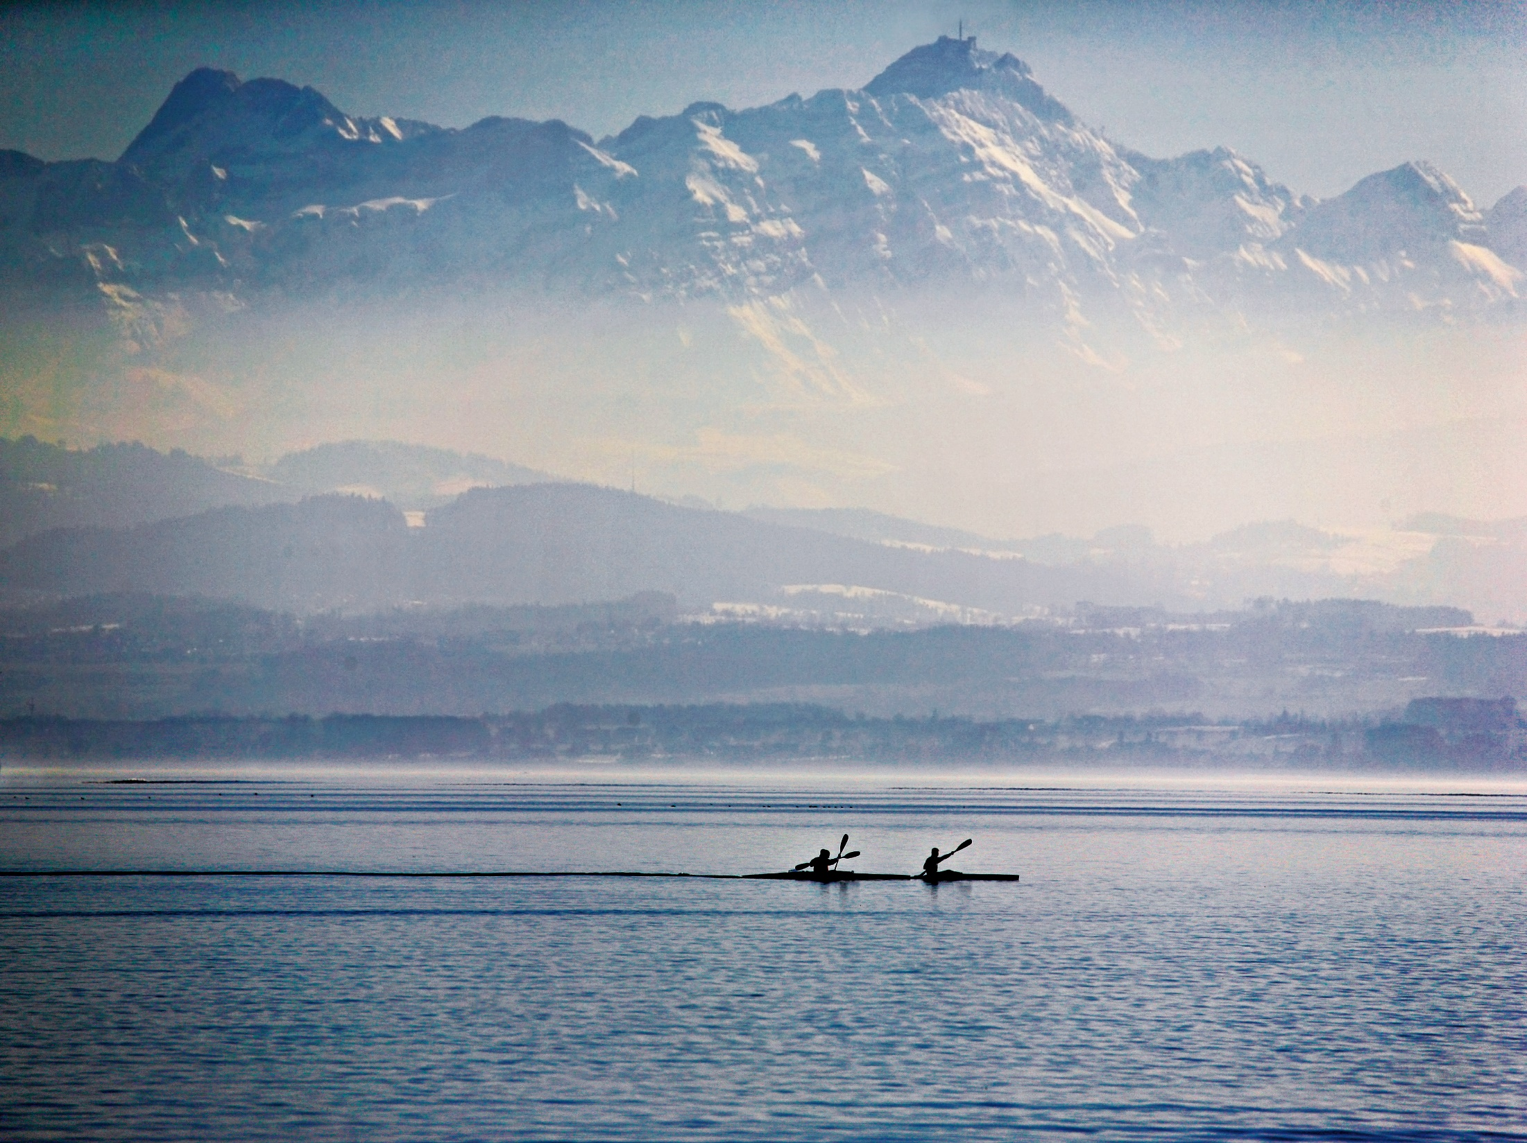

Slide 10
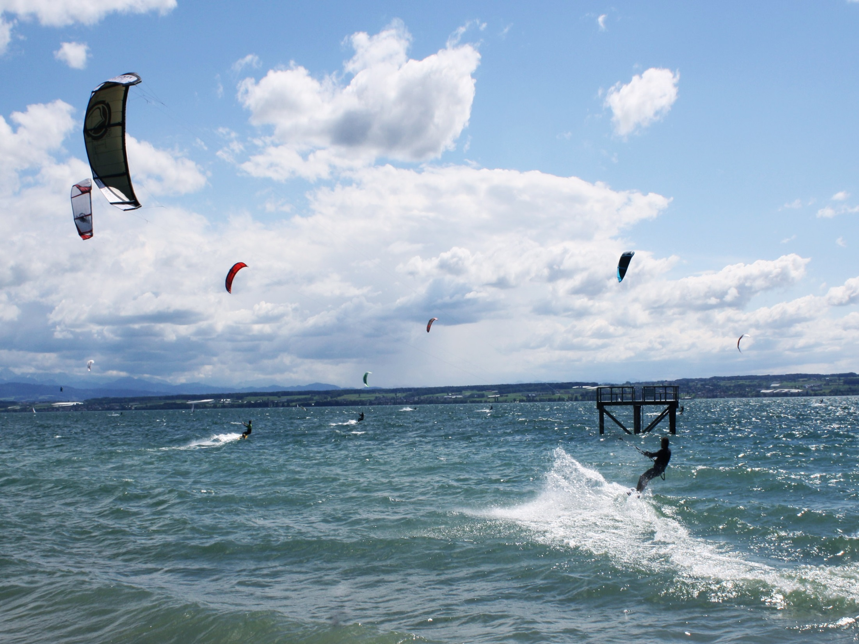

Slide 11
We are no longer afraid of God.
For you have not received a spirit of slavery leading to fear again, but you have received a spirit of adoption as sons by which we cry out, “Abba! Father!”
Rom. 8:15

Slide 12
We are assured of being a child of God.
The Spirit Himself testifies with our spirit that we are children of God.
Rom. 8:16
1Jn. 5:6,9-12; Is. 43:13

Slide 13
We belong to the family of God.
Whoever believes that Jesus is the Christ is born of God, and whoever loves the Father loves the child born of Him.
1Jn. 5:1

Slide 14
We become like the Son of God.
If you know that He is righteous, you know that everyone also who practices righteousness is born of Him.
1Jn. 2:29 (Heb. 8:10-12)

Slide 15
“Whoever believes in Him”
He has said yes to me, He waits for me to say yes to Him. (Rom.5:8)
Jesus came the first time to save, not to judge.
(Jn. 3:17-19; 12:47-48)

