Slide 1
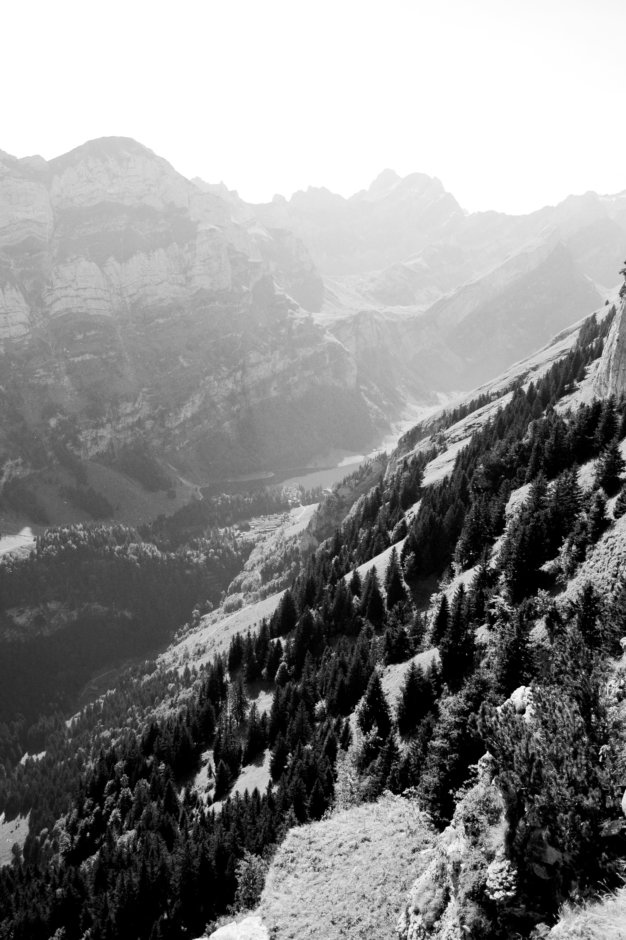

Slide 2
The First Sign
Jn. 2:1-11

Slide 3
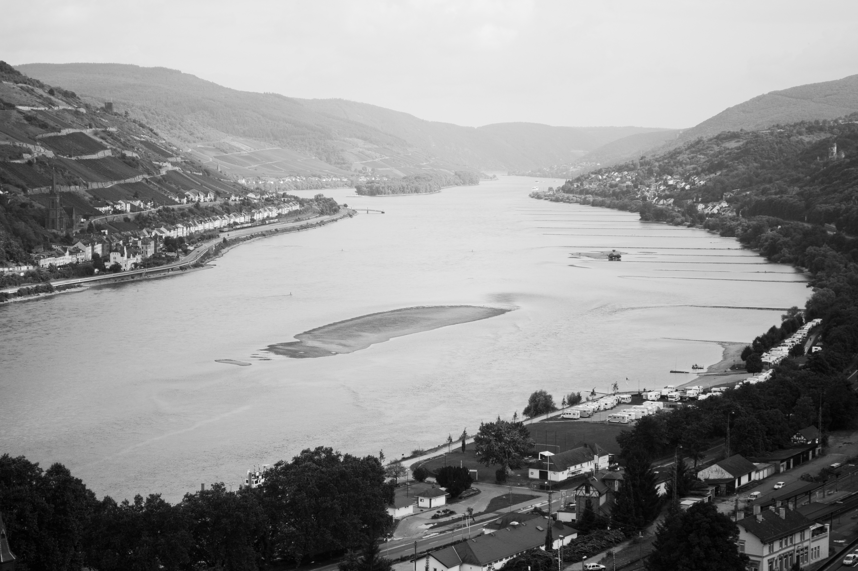
Mary vs. 1-5
The Announcement: Lk. 1:26-38
The Meeting with Elizabeth: Lk. 1:39-56
The Birth of Christ: Lk. 2:1-7
The Flight to Egypt: Mat. 2:13-23
The Boy Jesus in the Temple: Lk. 2:41-52

Slide 4
Disciples vs. 6-11
To experience His indwelling Life means I must come to Him on His terms, not mine.
Transformation is internal before it’s external.
His will and work is always the best.
Their need was not wine, but dependence on Jesus who made the wine.

Slide 5
Mary at Pentecost
The name Mary means, “Bitter”.
Through Mary Jesus was born, through Jesus Mary was born again! Acts 1:12-14
God fulfilled her desire. Ps. 145:19
Waiting for His timing is always worth it.

