Slide 1
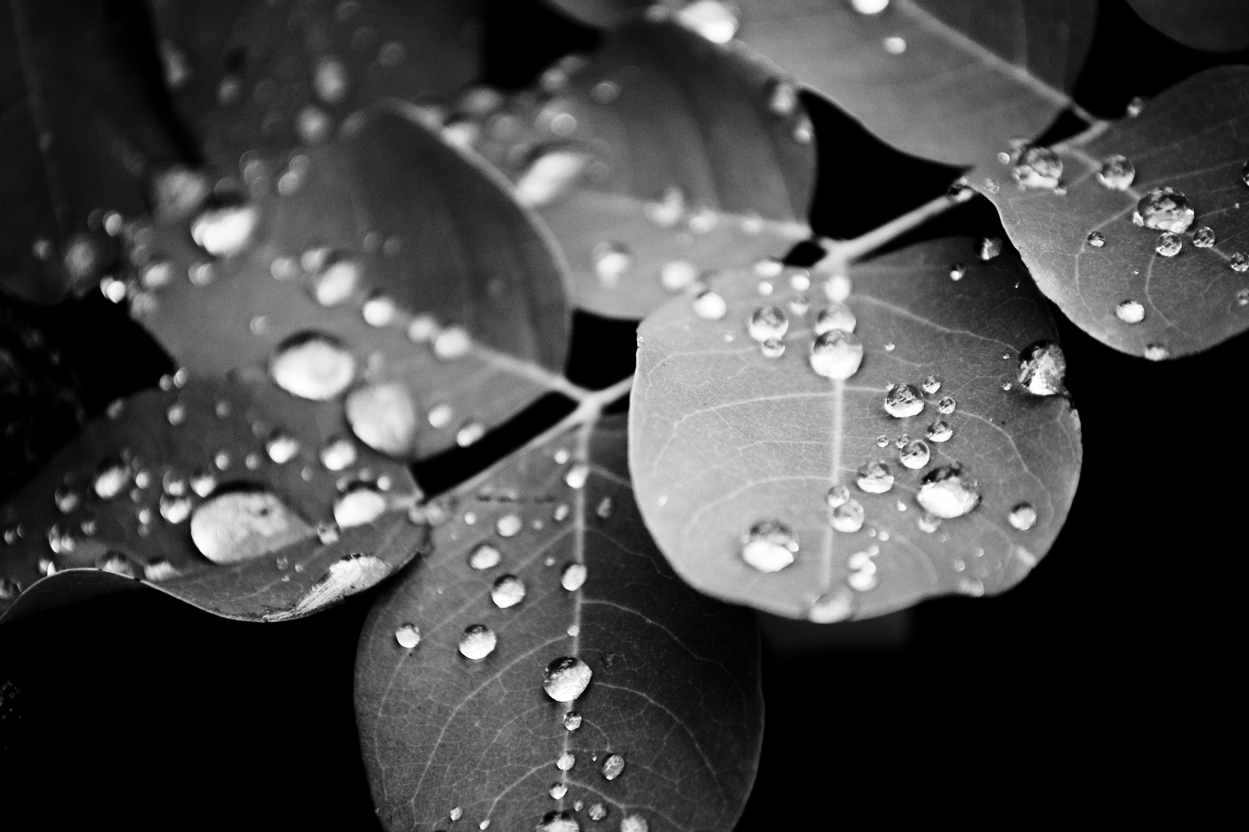

Slide 2
Healing of the Man at Bethesda
~ Jn. 5:1-18 ~

Slide 3
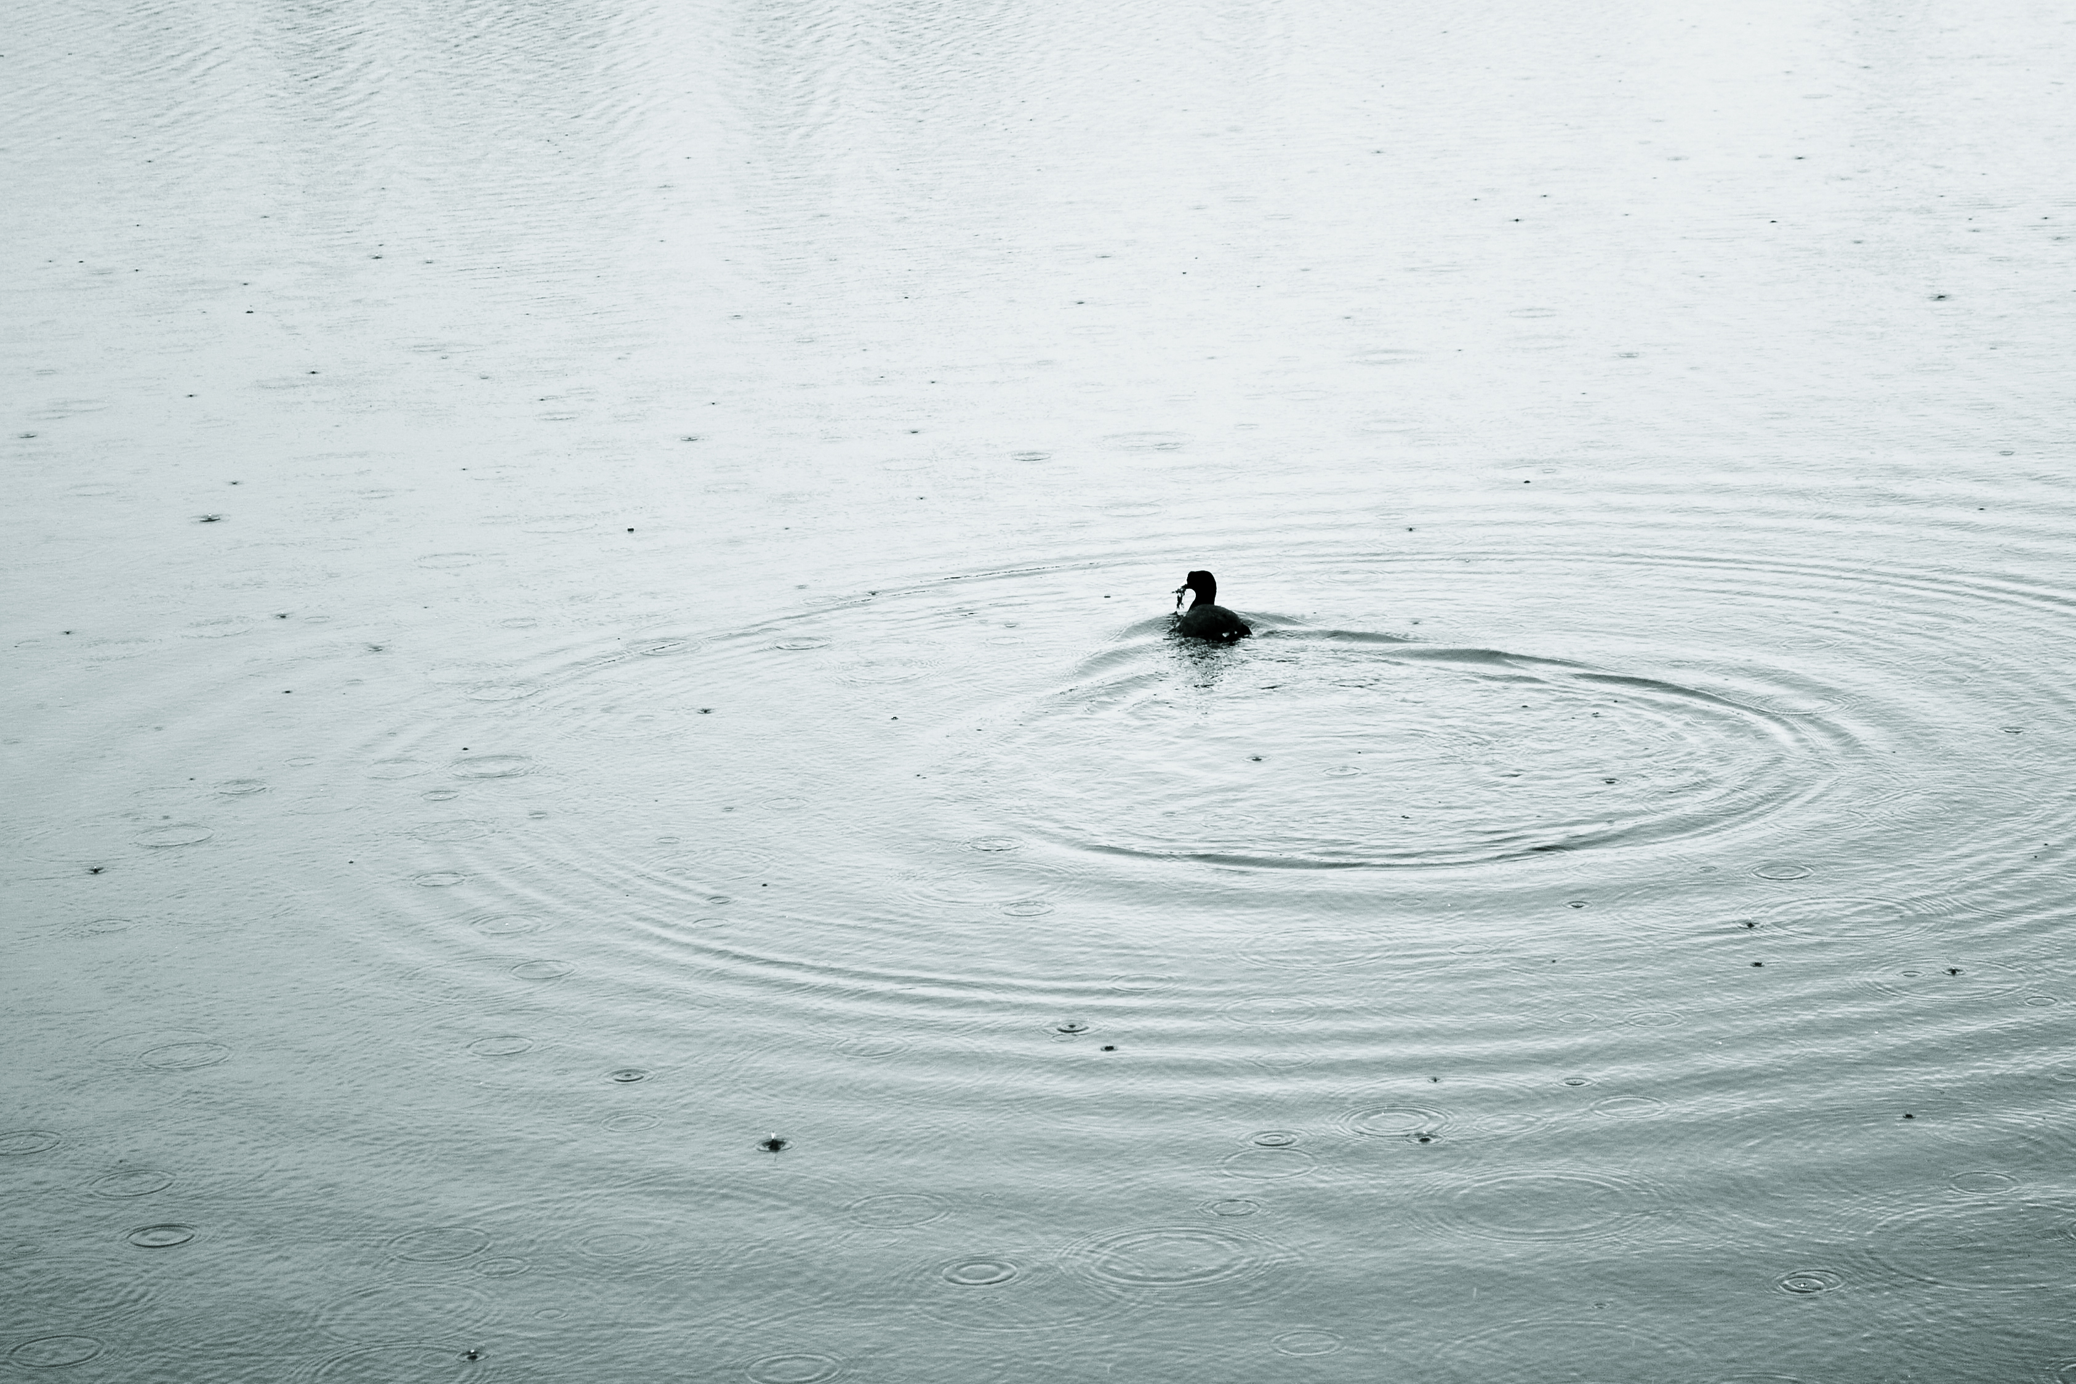
The Revelation. vs. 1-9
-Arise-
-Take Up Your Pallet-
-Walk-

Slide 4
"All the Almighty God is ours in the Lord Jesus. And He will tax the last grain of sand and the remotest star to bless us if we obey Him. What does it matter if external circumstances are hard? Why should they not be? If we give way to self-pity and indulge in the luxury of misery, we banish God's riches from our own lives and hinder others from entering into His provision. No sin is worse than the sin of self-pity, because it obliterates God and puts self-interest upon the throne. It opens our mouths to spit out murmurings and our lives become craving spiritual sponges, there is nothing lively or generous about them."
Oswald Chambers

Slide 5
Lessons on trusting His Indwelling Life:
Our failure does not influence His victory.
Only look back as far as it helps you to move forward.
What is extra-ordinary becomes ordinary.
Our obedience will create memories of His activity.

Slide 6
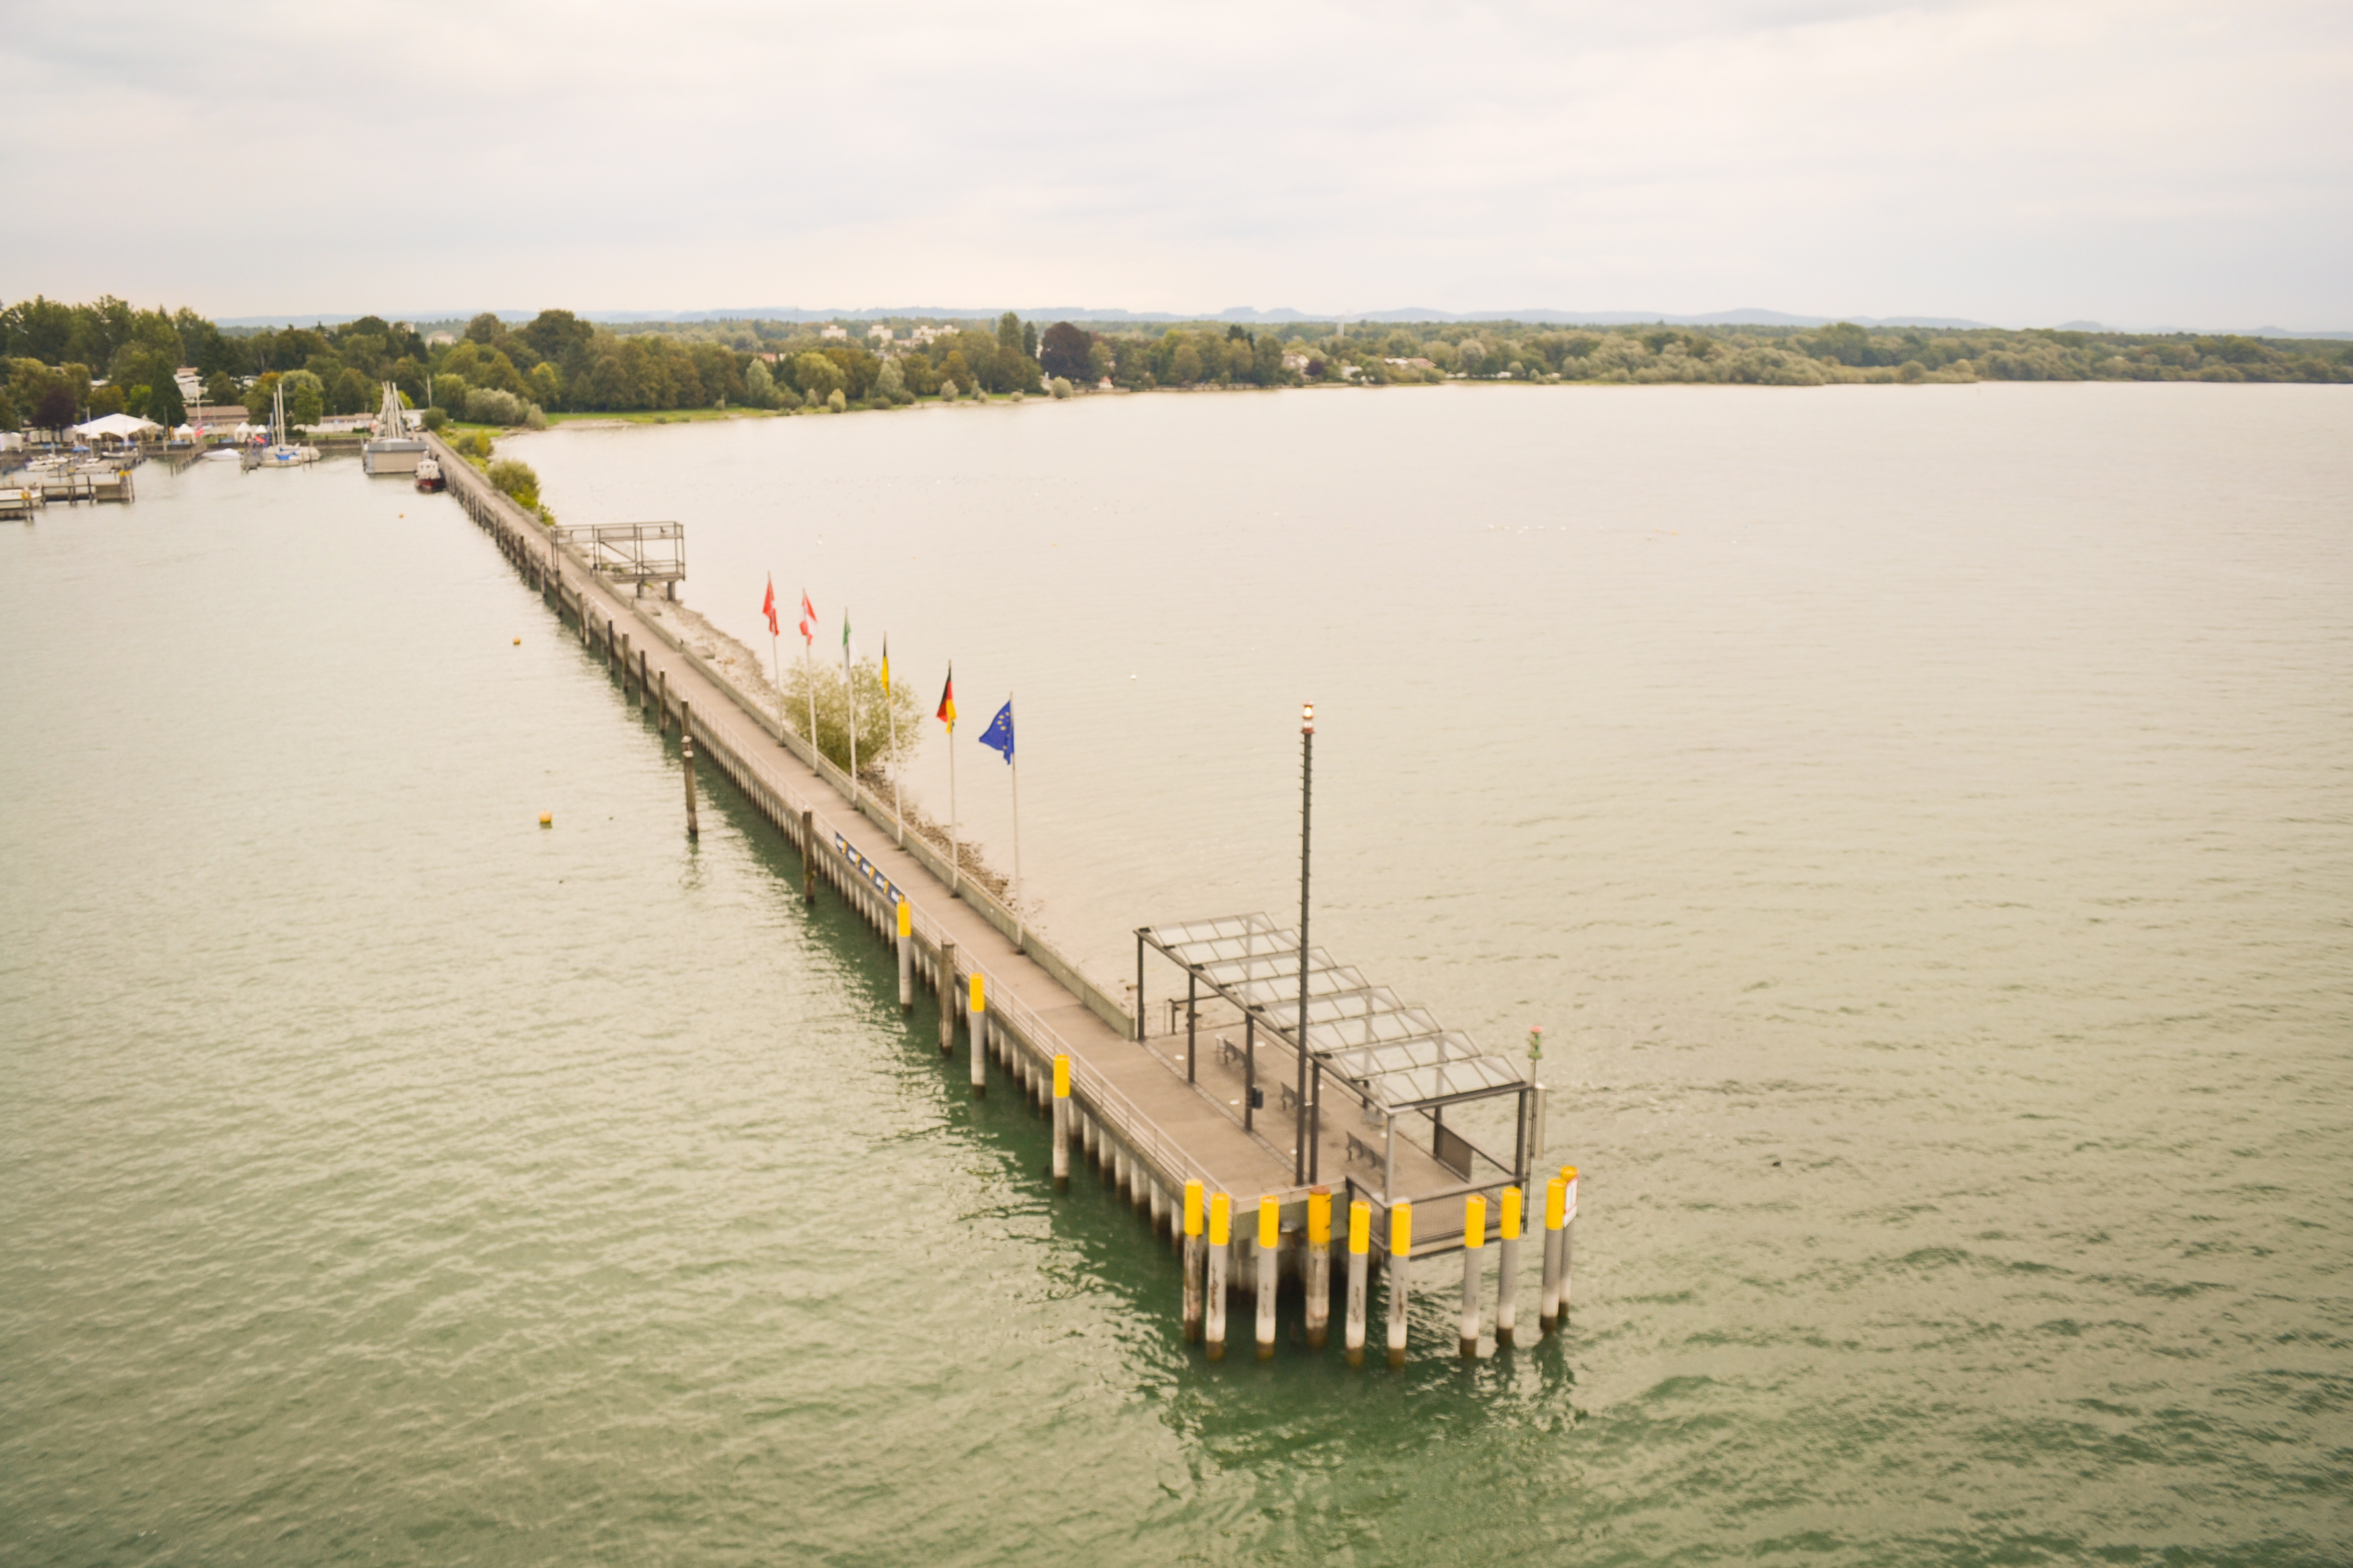
The Response. Vs. 10-20 Mk. 2:27-28

