Slide 1
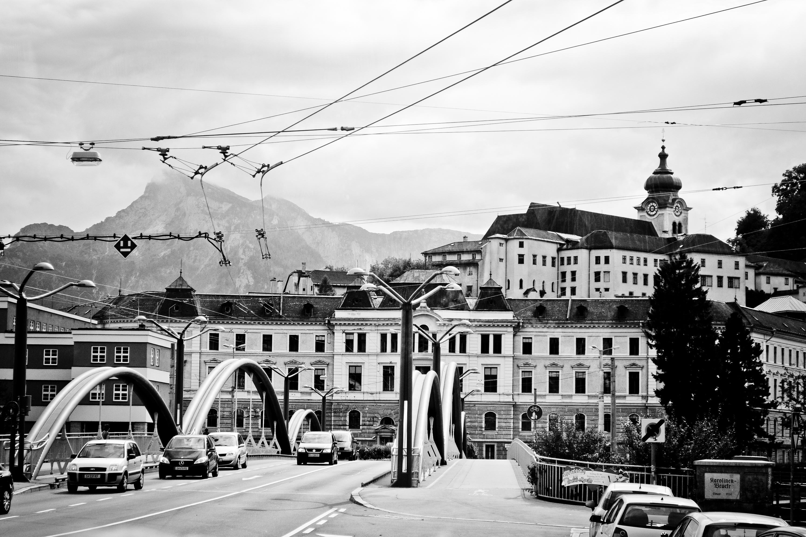
What’s over my head is under His feet.
Jn. 6:16-21
(Matt. 14:22-33)

Slide 2
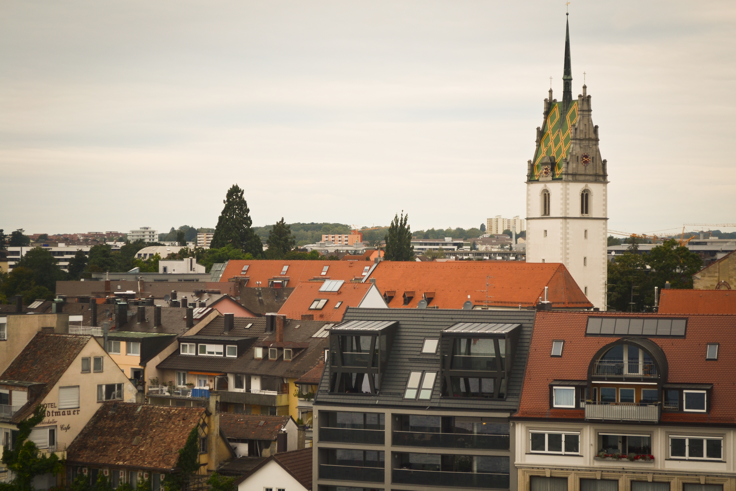
“Godliness is the attitude which considers dependence upon Jesus true happiness.”
Hermann von Bezzel

Slide 3
In the 6 months between Mk. 4 and Jn. 6, Jesus did the following:
1. He cast out the legion of demons.
2. He healed the hemorrhaging woman.
3. He raised Jarius' daughter from the dead.
4. He sent them out and empowered them to preach, cast out demons, and heal.
5. He just fed 10,000 people with 5 loaves and 2 fish.

Slide 4
"for they had not gained any insight for the incident of the loaves, but their heart was hardened."
Mk. 6:52

Slide 5
Jesus made them get into the boat!
Matt. 14:22

Slide 6
Those who had been through the storm stayed with Him.
(Jn. 6:66-69)

Slide 7
Lessons from this sign:
Circumstances are incidental to the Life of Christ within us.
Faith turns the waves into a bridge leading to the reality of Christ.
Pay attention to Christ, not your experience of Christ.
Truth lies in the minority, not the majority.

Slide 8
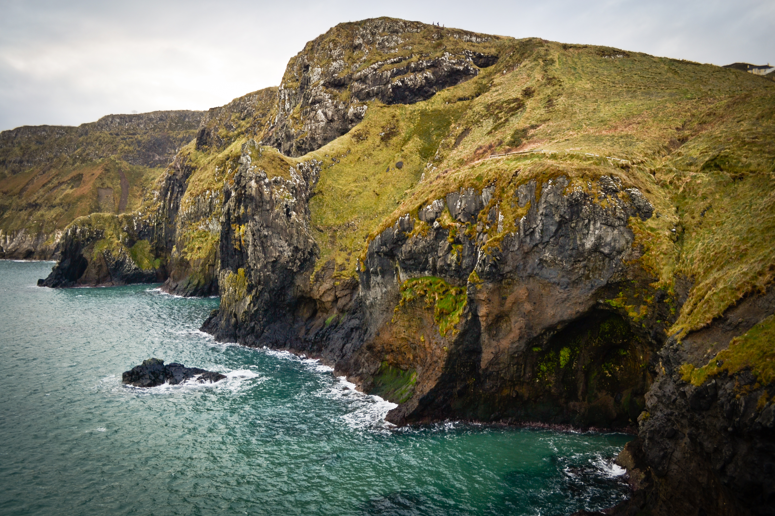
The Healing of the Blind Man. 9:1-12

Slide 9

The Marks of a Good Shepherd (Ch. 10)
3. Good shepherds lead others to The Good Shepherd. (vs. 24-29)
4. Good shepherds rejoice in God’s work wherever it takes place. (vs. 30-34)
5. Good shepherds have a teachable spirit.
(vs. 35-41)
Good shepherds are more concerned about the origin of their ministry than its content. (vs. 13-17)
Good shepherds are interested in people, not just followers. (vs. 18-23)

